Slide 1
July 26, 2023

Slide 2
Michigan Health Information Network Shared Services (MiHIN)
MiHIN is a non-profit organization that provides technology and services to connect disparate sectors to securely, legally, technically and privately share health information.
An unbiased data trustee, MiHIN does not provide health care services or produce health care data.
Instead, we help convene to share vital health information to advance care, better outcomes and lower costs.

Slide 4
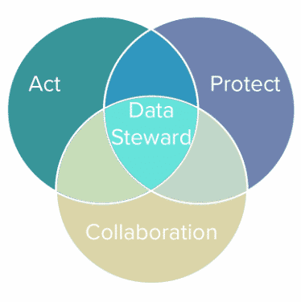
Data for Health; Data for Public Good
How can we support as you enhance patient safety and prevent medical errors?
How can we help you stay ahead of technological advancements and leverage our tech stack to improve healthcare delivery?
How can we help you effectively navigate and adapt to changing healthcare regulations and policies?
How can we help you manage and optimize healthcare data for better decision-making?

Slide 5
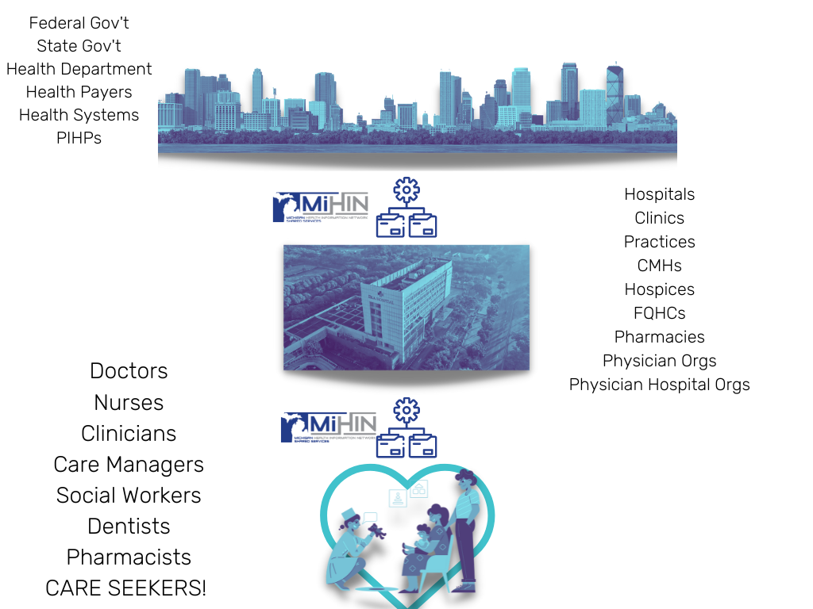
44,582
Michigan care providers with
Active Care Relationships®
through MiHIN, working within
5,637
Michigan care entities
13.1M
Unique Patient Records

Slide 6
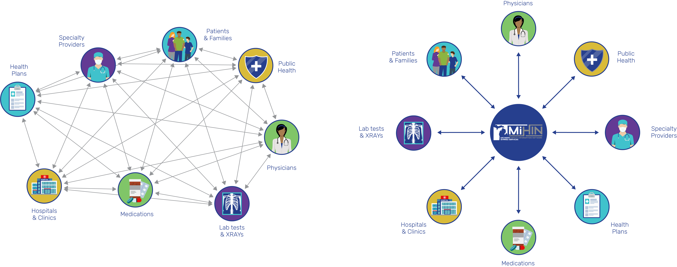
Statewide Health Information Exchange
Breaks Down Data Silos and Creates Efficiency
Efficient and cost effective
Duplication of effort, waste and expense

Slide 8
Policy Themes [About] A Year in Review
Shreya Patel
Chief Policy & Privacy Officer

Slide 9
01
National Interoperability
02
Information Blocking
THEMES
03
Behavioral Health
04
Cross Sector Data Sharing
05
Fast Healthcare Interoperability Resource (FHIR)

Slide 10
National Interoperability

Slide 11
Trusted Exchange Framework and Common Agreement (TEFCA)

Slide 12
TEFCA Defined
What is TEFCA?
Trusted Exchange Framework
Common Agreement
Origins
21st Century Cures Act (2016)
Directed ONC to establish a framework for exchange between health information networks (HINs)

Slide 13
Goals
Universal policy and technical floor for national interoperability
Simplify connectivity and increase health exchange
Enable individuals to gather their own information

Slide 14
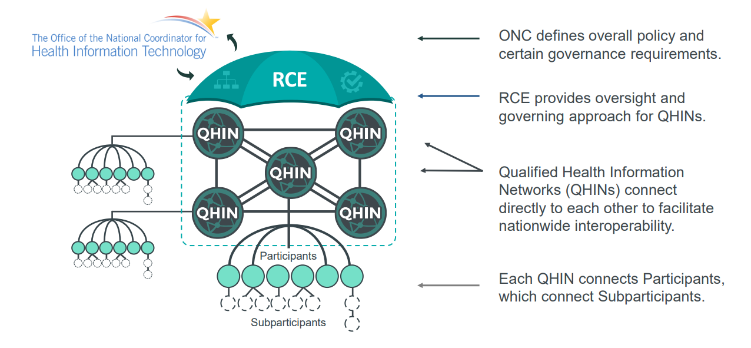
Source Sequoia Project: https://rce.sequoiaproject.org/wp-content/uploads/2022/01/RCE-Overview-of-the-Common-Agreement-Jan-26-FINAL.pdf

Slide 15
TEFCA Components
Common Agreement
Standard Operating Procedures
Trusted Exchange Framework
QHIN Technical Framework

Slide 16
What Are Recent Developments?
Provisional QHINs
Opt In/ Opt Out Notices
Standard Operating Procedures

Slide 17
Why Does This Matter to Us?
Expanding existing exchange
Compliance requirements
Exchange Purposes
Information Blocking

Slide 18
Information Blocking

Slide 19
What does the Rule say?
The Rule prohibits Actors from engaging in practices that are likely to interfere with the Access, Exchange or Use of EHI.
The Information Blocking Rule is intent based. That means failure to satisfy a Safe Harbor does not mean that there is a violation of the Information Blocking Rule. However, most organizations strive to satisfy the conditions of any applicable Safe Harbor when engaging in practices that might implicate the Information Blocking Rule.

Slide 20
OFFICE OF THE NATIONAL COORDINATOR FOR HEALTH IT
FINAL RULE
Who is subject to the rule?
HEALTHCARE PROVIDERS HIES/ HINS
CERTIFIED HEALTH IT DEVELOPERS (ONC PROGRAM)

Slide 21
ONC Information Blocking Provisions
Exceptions
01.
Preventing Harm
02.
Privacy
08.
Licensing
03.
Security
07.
Fees
04.
Infeasibility
06.
Content and Manner
05.
Health IT Performance

Slide 22
Our Involvement and Resources
Resources:
Crosswalk of Applicability
Summary Documents
Frequently Asked Questions
Internal Activities:
Task Force Compliance Plan Completion
“No” Information Blocking Policy

Slide 23
Why Does This Matter to Us?
Actor subject to the rule
Enforcement beginning
Participation in HIE/HIN
Data flows
Documentation

Slide 24
Comment Submission

Slide 25
Behavioral Health

Slide 26
42 CFR Part 2: Answering Your Questions
What is Part 2?
What is the need for Part 2?
How is this different or distinct from Behavioral Health generally?
What are misconceptions concerning behavioral health sharing
What has changed?

Slide 27
42 CFR Part 2: Confidentiality of Substance Use Disorder Records
What did the rule change address?
Alignment with HIPAA
Consent
Redisclosure
Accounting of disclosures
Notice of Privacy Practices
How does this affect Us?
One time consent allowed with general designation for Health Information Networks and Exchanges
Removes barriers to sharing substance use disorder information
Any gaps to address?
eConsent Use Case
Source: Confidentiality of Substance Use Disorder (SUD) Patient Records https://www.federalregister.gov/documents/2022/12/02/2022-25784/confidentiality-of-substance-use-disorder-sud-patient-records

Slide 28
Why Does This Matter and How We Can Support with Behavioral Health Sharing?
eConsent
Collaborative forums
Policy Interpretation
Updating internal practices
New use case creation

Slide 29
Cross Sector Data Sharing

Slide 30
Hospital Inpatient Prospective Payment System (IPPS) Long Term Care Hospital Prospective Payment System 2023 (LTCH PPS)

Slide 31
Why does it matter to us?
Proposed changes for 2023.
IPPS is proposed changes to hospital requirements for reporting as well as Conditions of Participation (i.e., what hospitals must meet to receive Medicare funding) for 2023.
Notes:
We will go over our comments and solicit feedback from the Download attendees.

Slide 32
What is covered in the Proposed Changes?
Medicare Maternal Health
Maternal Health Equity
Health Equity
Social Determinants of Health (SDOH)
Health Related Social Needs (HSRN)
Supplemental Payments for Indian Health, Tribal Health, and Puerto Rico
Measuring Healthcare Quality Disparities
And more
Notes:
[TO BE FILLED IN]

Slide 33
Health Equity
Social Determinants of Health (SDOH)
Health Related Social Needs (HRSN)
Screening
Hospital Commitment to Health Equity Measure
Strategic planning that prioritizes equity
Improved data collection
Effective data analysis
Quality improvement efforts
Leadership engagement on fostering a culture of equity.
Notes:
[TO BE FILLED IN]

Slide 34
Healthcare Quality Disparities and Healthcare Equity in Long Term Care Hospitals
Want to look at how SDOH can be attributed to clinical and non clinical factors
How to narrow gaps in outcomes, help LTCH address gaps in facilities
Equity for inclusion
Reward Health equity summary score
Hospital Commitment to Health Equity
providers that demonstrate good performance in care to those with social risk factors
Request for information
Guiding principles for selecting and prioritizing measures for disparity reporting across CMS quality programs
Principles for social risk factor and demographic data selection and use
Identification of meaningful performance differences
Guiding principles for reporting disparity results.
Notes:
[TO BE FILLED IN]

Slide 35
Our Comments to IPPS Rule
Insight into how reported data will be actionable moving forward
Listing HIEs as a resource for meeting certain measures or as evidence of effort
Clarity on sharing information with community based organizations for SDOH and HRSN
Updates to Notice of Privacy Practices to preserve patient autonomy
Promote incentives over penalties
Notes:
[TO BE FILLED IN]

Slide 36
Fast Healthcare Interoperability Resource (FHIR)

Slide 37
21st Century Cures Act
Purpose: To accelerate medical product development and bring new innovations and advances to patients who need them faster and more efficiently
01
Think of this as a “catch-all” healthcare bill, the same way the HITECH Act was
Important Provisions
Section 4001: Health IT Usability
Section 4002 (a): Conditions of Certification
Section 4003 (b): Trusted Exchange Framework and Common Agreement
Section 4003 (c): Health Information Technology Advisory Committee
Legislation allows Congress to give the authority to HHS (the ONC and CMS) to take action and act on Congress’ directives
02
Section 4004: Identifying reasonable and necessary activities that do not constitute information blocking
Title IV is where you will find the majority of the information that will apply to Velatura information sharing. E.g. Patient Access Rule; Information Blocking
03
Source: H.R.34 - 21st Century Cures Act (2015-2016) https://www.congress.gov/bill/114th-congress/house-bill/34

Slide 38
21st Century Cures Act Interoperability Mandates
ONC Trusted Exchange Framework and Common Agreement USCDI v3 Inpatient Prospective Payment Systems Rule
CMS Patient Access Rule ONC Information Blocking Rule
ONC USCDI v1
Compliance for 2023 CMS Mandates
2016
2020
2021
2022
2023
2026
21st Century Cures Act
CMS Conditions of Participation USCDI v2
CMS Proposed Rule: Prior Authorization API
Payer to Payer API
Provider Access API USCDI v4

Slide 39
Fast Healthcare Interoperability Resources (FHIR)
Standard which defines data formats, elements, and an application programming interface (API).
Eases the complex barriers for healthcare interoperability.
Advantages of FHIR include:
Standard for data querying
Support from major vendors and government entities.
FHIR Resources that provide building blocks for a modular framework.
Using modern internet technologies and protocols.
Linking FHIR Resources together to tell a story.
Authorization and authentication for data access.
What is FHIR?
Notes:
(FHIR) as a standard to define data formats, elements, and application programming interfaces or (APIs) for data exchange. APIs enable the secure transfer of information between people and apps.
By using APIs, FHIR takes an internet-based approach to making PHI available to allow access to patients, providers, and payers. It's an efficient and safe way to share patient data across the healthcare ecosystem and it's rapidly advancing interoperability efforts where previous standards have failed.
The main goal of FHIR is to ease the complex barriers that exist for healthcare interoperability.
Some advantages of FHIR include:
availability of a standard for data querying
introduction of an open standard for all healthcare data
support from major vendors (such as Epic and Cerner) and government entities
FHIR Resources that provide building blocks for a modular framework
Uses modern internet technologies and protocols
linking FHIR Resources together to tell a story

Slide 40
2023 Mandates from 21st Century Cures: FHIR Based Exchange
Prior Authorization
Prior Authorization Requirements, Documentation, and Decision FHIR API
Fully integrated API which can automate process of pulling Prior Authorization elements from medical record
Payer to Payer Exchange
Share information with existing and concurrent payers through FHIR API
Provider Access API
Create FHIR API for providers to access information on their patients
Leverage Health Information Networks for provider patient attribution
Source: Advancing Interoperability and Improving Prior Authorization Processes for MA Organizations and Medicaid Managed Care Plans, State Medicaid Agencies, State CHIP Agencies, CHIP Managed Care Entities, and Issuers of QHPs in the Federally-Facilitated Exchanges (CMS-0057-P)CMS-2022-0190), released in 2023. Prior Authorization: https://www.federalregister.gov/d/2022-26479/p-78 Payer to Payer: https://www.federalregister.gov/d/2022-26479/p-396
Provider Access API: https://www.federalregister.gov/d/2022-26479/p-277

Slide 41
How Does this Affect Us?
Current Offering
InterOp Station helps affected payers fulfill the Patient Access API requirement
This allows individuals to exercise their Right of Access through third party applications
To continue to support payer community, it will require:
Building a fully integrated FHIR API for PARDD
Outlining provider and patient attribution process
Providing provider education on new Provider Access API
Beginning payer to payer exchange utilizing FHIR Bulk
Compliance date is TBD, but it will begin in 2026

Slide 42
Provider Impact for Prior Authorization
PARDD
Prior authorization requirement transparency
Ability to automate information sharing
Provider Access API
Ability to view patient information
Ability to view past approvals and denials

Slide 43
What Else?

Slide 44
Other Priorities We Have Seen
Maternal Health
Reproductive Health
Patient privacy
Tribal Health

Slide 45
Questions?

Slide 46
Thank you!
Shreya Patel
Chief Privacy and Policy Officer
shreya.patel@mihin.org

