Slide 1
September 27, 2023

Slide 2
FHIR 101

Slide 3
Michigan Health Information Network Shared Services (MiHIN)
MiHIN is a non-profit organization that provides technology and services to connect disparate sectors to securely, legally, technically and privately share health information.
An unbiased data trustee, MiHIN does not provide health care services or produce health care data.
Instead, we help convene to share vital health information to advance care, better outcomes and lower costs.

Slide 4
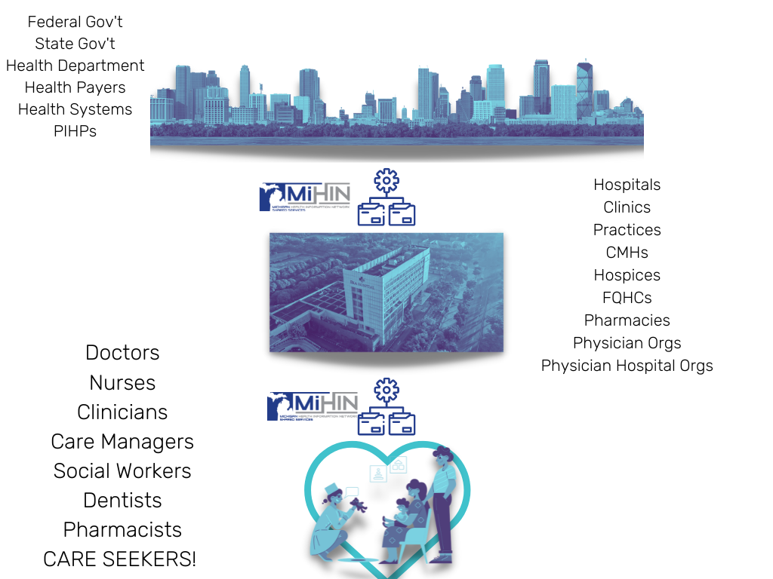
44,582
Michigan care providers with
Active Care Relationships®
through MiHIN, working within
5,637
Michigan care entities
13.1M
Unique Patient Records

Slide 5
FHIR 101

Slide 6
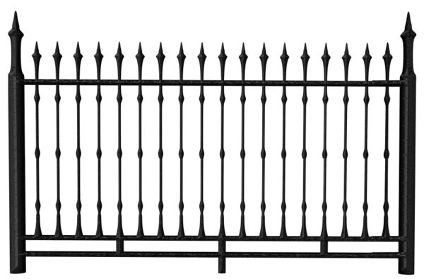
Historically, interop has been a journey.
Traditional interop → message evaporates
Proprietary APIs
Proprietary APIs
Proprietary APIs
Proprietary APIs
Data locked behind walled gardens
Notes:
We can see on the left side, our source systems, a bunch of proprietary APIs. We go through data mapping and data transformation exercise to get the source data into an interop message. We deliver the interop message and then the message evaporates and disappears. Once we deliver it, we have to reverse the data transformation process. We need to deserialize the data, put it back into a proprietary system where it's once again locked behind these walled gardens.

Slide 7
FHIR is both a journey and a destination
FHIR interop → FHIR persists
Proprietary APIs
FHIR
Proprietary APIs
FHIR
Data is liberated
Notes:
FHIR is both a journey and a destination.
Now, with FHIR, we only have to do that data transformation exercise once, just upon getting the data out of the source system.
Once the message has been delivered in FHIR, ideally, it's going to persist in FHIR.
We reduce the cost of data, cutting mapping and transformations in half, because we don't have to do it on the destination side, and we have the big benefit of having our data in FHIR--open, universal, and free for you to use the way you want.

Slide 8
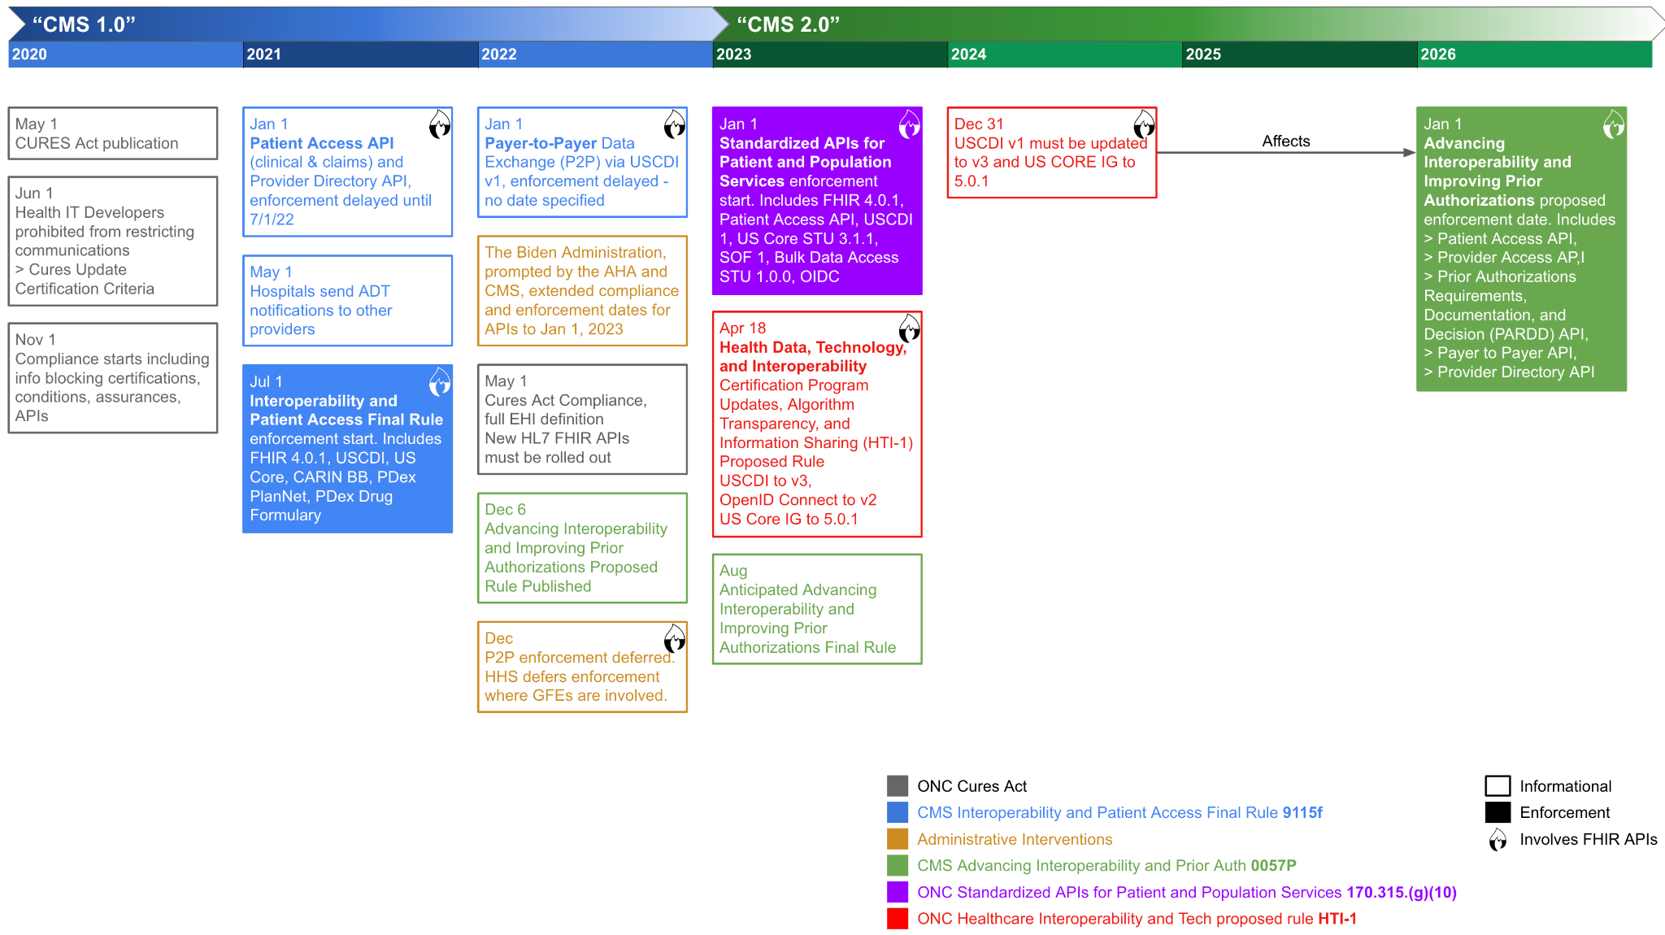
Regulatory Timeline
Notes:
Most of you are, are well aware of the regulatory timeline. The key thing that I want to focus on here are the shaded boxes--the blue, purple, and green boxes. These are the enforcement dates.
The first one, the blue box in July of 2021bwas for the payers. This is the patient access API regulated by CMS.
Earlier this year, we see the sister set of regulations impacting the provider community.
And then the next big one is the one in green, Advancing Interoperability and Improving Prior Authorizations, with enforcement kicking in on January 1 of 2026.
What makes this one particularly complex is the prior authorization that breaks down into 3 significant implementation guides. And it's a bit of a moving target right now.
CMS and ONC are being proactive in pushing automation around prior authorization. The downside of that is, it is a bit of a moving target.
Talk to MiHIN about your collective prior authorization plans to achieve economies of scale.

Slide 9
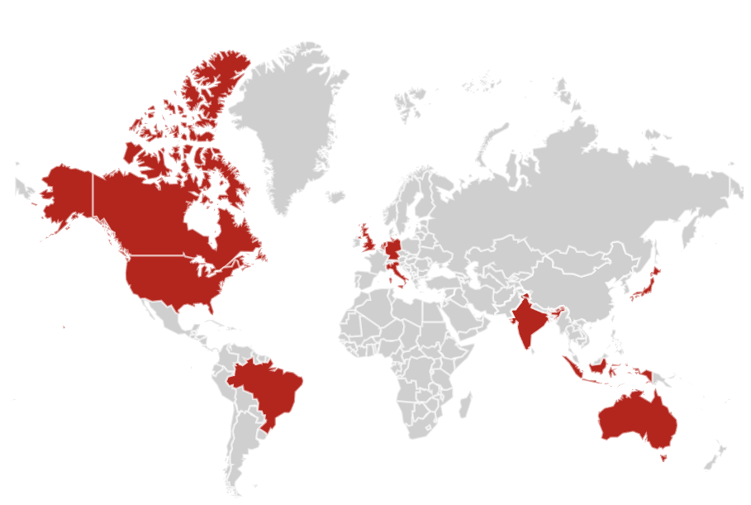
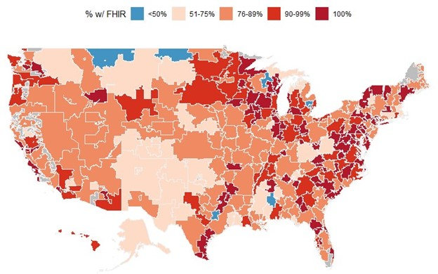
FHIR: State Of The Union
Interest over time (Google Trends)
 | HL7 FHIR
 | HL7 v2
 | HL7 CDA
Percent of all hospitals that adopted and implemented certified API technology enabled with FHIR in 2019, by healthcare referral region (HRR)
Notes:
I joined Smile 3.5 years ago, and since then FHIR has exploded. How much of that is my perception vs. reality. And particularly, was the introduction of the Patient Access API the peak for FHR, did things level off after that?
So I thought a good place to start this morning with a State of the Union of FHIR.
Most of us know the Patient Access API is seeing slow adoption by patients, but lots of demand from interop - particularly as CMS has an aggressive agenda of FHIR-based use cases
According to Google Trends, we’re seeing consistent interest in HL7 v2, a slow decline in interest around CDA, and a strong and steady rise in interest in FHIR.
Currently there is about 10x as much interest in FHIR as there is in v2 and CDA combined!
These trends are global, and they are also replicated in the US.
While there is strong interest in FHIR around the globe, peak areas include North America, Asia-Pacific, and Western Europe.
In the US, there is very high adoption of FHIR in hospitals, particularly in urban centers
https://trends.google.com/trends/explore?date=2012-05-01%202023-08-29&q=hl7%20v2,hl7%20fhir,hl7%20cda
https://www.healthit.gov/buzz-blog/health-it/the-heat-is-on-us-caught-fhir-in-2019

Slide 10
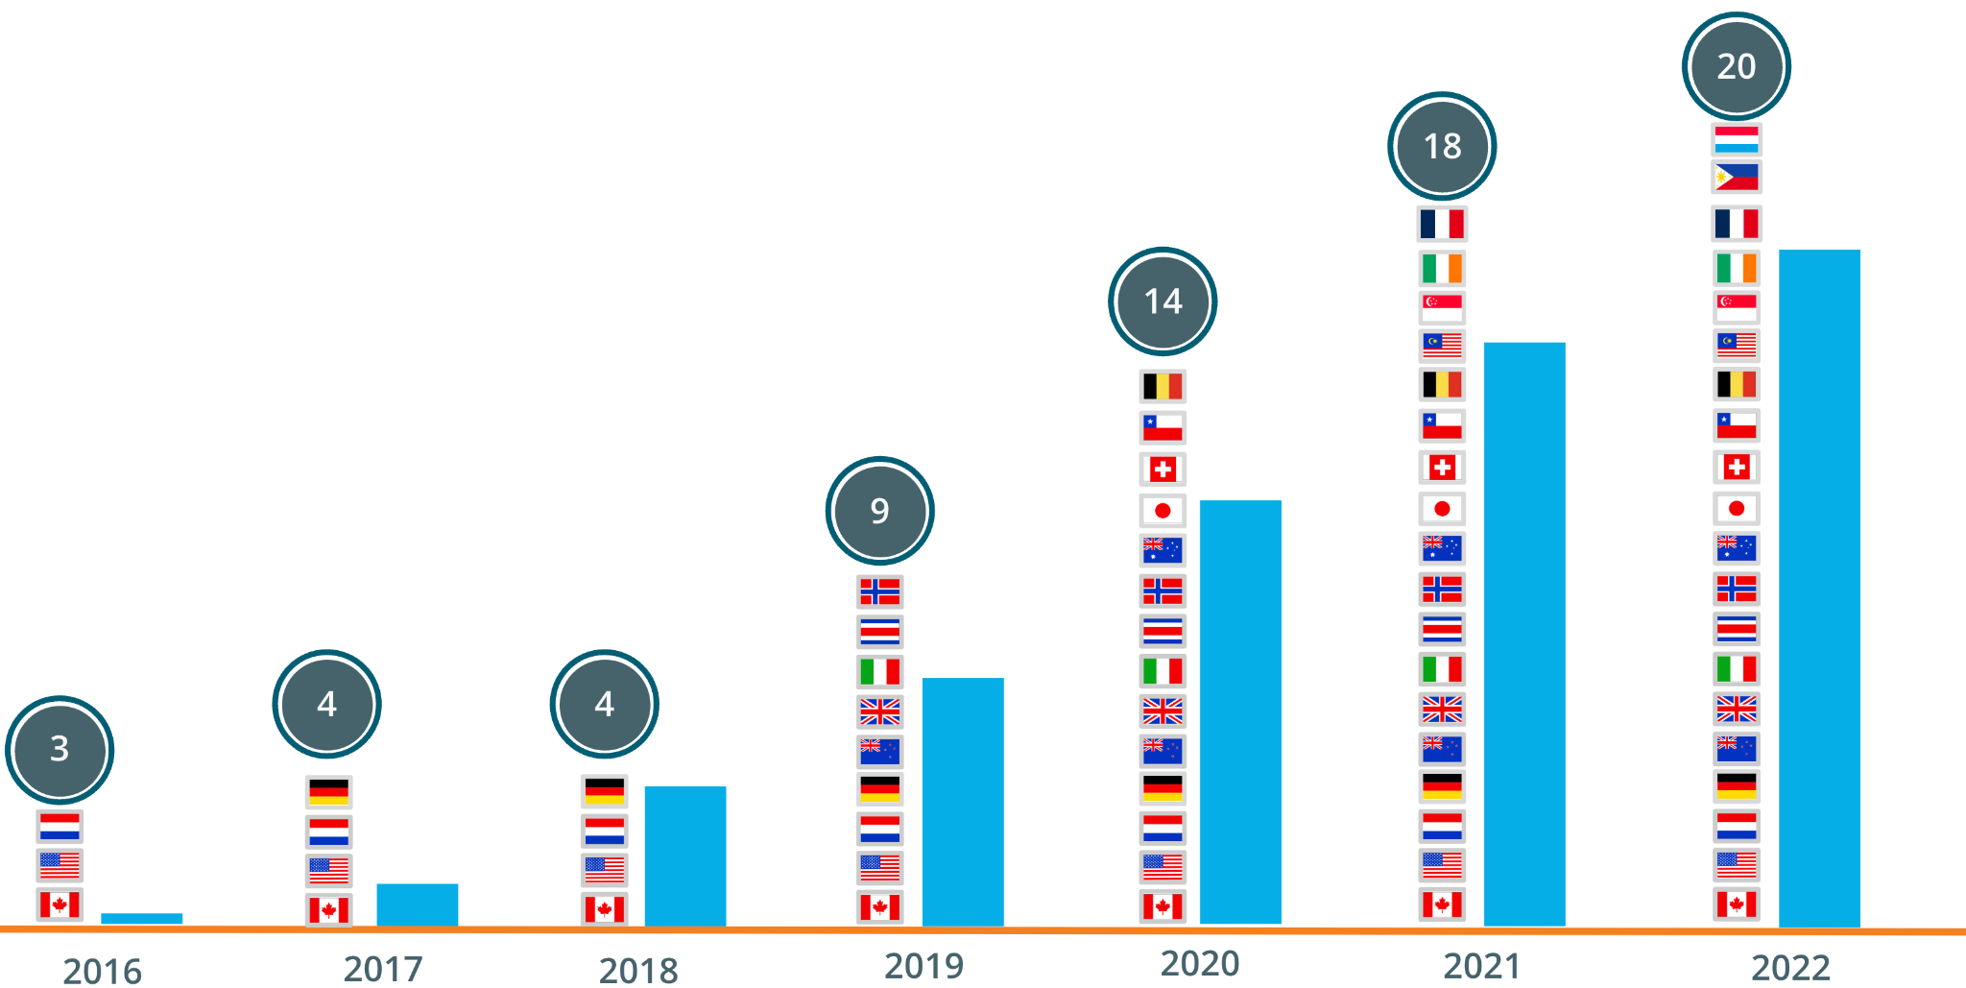
FHIR: State Of The Union
Notes:
FHIR adoption through the lens of Smile is similar to the global perspective
Steady and significant growth
Not just a US phenomenon; FHIR is truly global
Largest market is the US followed by Canada, and then South-East Asia
Having said that, the US dominates our activities

Slide 11
FHIR: State Of The Union
Notes:
The CDC notes that FHIR is emerging as a lingua franca to promote interoperability. That statement, I think, summarizes every everything we need to know right there. Just diving a little bit deeper into some of the other statements, we can see that the CDC is also quite bullish on bulk FHIR, and of course, FHIR for an interoperability Standard nationwide.

Slide 12
Universal Data Objectives & Challenges
A single source of truth is a must, but it’s incredibly challenging when data is scattered among hundreds of disparate legacy, cloud, and hybrid systems.
The volume of data is growing exponentially, with increasing demand for instant data access and faster response times.
Data needs to be made available to everyone, all the time, without the need for technical expertise or any involvement of IT.
Data is a competitive advantage, it is valuable but only as much as it is trustworthy (hygienic, complete, organized, current), frictionlessly accessible to those who derive value
Notes:
Lets set a common understanding of the objectives and challenges we all face when working with data.
We all want a single source of truth. And it's challenges. We know that our data is scattered across a number of different systems and bringing it together and getting that consistent source of truth has been a significant, perennial challenge and a blocker to number of business value adding activities.
The volume of data is growing exponentially, and we want access to our data with very fast response times.
Key business decisions and insights are made on this data. We focus on liberating the data and making it available to us all because we're all knowledge workers and doing so unlock competitive capabilities.

Slide 13
Open-standards Health Data Fabric
 | Business Agility
Computable CPGs | Burden Reduction | Prospective Care gaps | Real-time DQMs | Seamless data sharing | Innovation Sandboxes | Self-learning analytics
NLP / AI
Golden Record
CQL
Endpoint discovery
Event Driven Architecture
Clinical Decision Support
Workflow/ BPM+Health
Data Harmonization
Normalize (codify, terminology)
Reconcile (MDM, De-dupe)
Hygiene (auto/man, fill gaps)
Relationships (referential integrity)
Versioning (current, Hx maintained)
Metadata (consent, provenance,...)
HL7
PHR
Rdlgy
Device
EHR
Emerg
ETC
CDA
Notes:
The term “data fabric” was coined several years ago by Gardner. Gartner had intended it to be industry agnostic. You'll hear other similar terms like “data mesh.”
One of the really neat things about FHIR is we get 80-90 % of the core capabilities of a data fabric for free with FHIR.
When Gartner defines a data fabric, they say: one of the fundamental things you need is a common data schema. FHIR is is highly opinionated about a common data schema. Likewise, regarding the state of data fabric, you want to have common terminology. FHIR has code sets and value sets and a strong focus on terminology.
Similarly, around restful Apis and identity management, etc., core capabilities of it, other data, fabric, and all for free and FHIR, because FHIR.
With that in mind, what we're seeing at the bottom are our various source systems. We can see how these source systems feed up into our data fabric. And as they feed up into our data fabric, they go through a data harmonization process where we normalize the data, we do data hygiene functions on it so that data quality is brought in up front, and that really helps us get over the syndrome that we've all encountered in the past of garbage in-- garbage out.
With consistent, high-quality data in our data fabric our engineers, our data scientists, our health informaticists are free to focus on the higher order business value adding capabilities, like the ones we see under the business agility headline, rather than focusing time on all of the plumbing that's happening underneath the surface. Over time we can add capabilities to the data fabric.
For example, burden reduction as a business capability is going to be dependent on the golden record. So, we introduce golden record to the health data fabric. Now that it’s been introduced to the data fabric, the golden record is available to us universally.
So over time, the data fabric gains more and more capabilities. FHIR is just an incredible way to recognize the value of the concept of a health data fabric.

Slide 14
Health Data Fabric
Each Successive Solution Becomes Easier to implement and accrues value to the ecosystem
Patient Access API | Payer-to-Payer | Prior Auth | Price Transparency | HEDIS | ADT Payer/Provider
Interop (data mapping, hygiene,... Infra (Sec, auth, API GW,...) Contracting Support Updates | Interop (data mapping, hygiene,... Infra (Sec, auth, API GW,...) Contracting Support Updates | Interop (data mapping, hygiene,... Infra (Sec, auth, API GW,...) Contracting Support Updates | Interop (data mapping, hygiene,... Infra (Sec, auth, API GW,...) Contracting Support Updates | Interop (data mapping, hygiene,... Infra (Sec, auth, API GW,...) Contracting Support Updates | Interop (data mapping, hygiene,... Infra (Sec, auth, API GW,...) Contracting Support Updates
FHIR | FHIR MDM | FHIR MDM CDS Hooks CQL Forms | FHIR | FHIR MDM CQL BPM+Health NLP | FHIR MDM CDS Hooks CQL BPM+Health
SoF FHIR Gateway Subscriptions IGs (automated) PMP appSphere | SoF FHIR Gateway Subscriptions IGs (automated) OLAP P2P Pt & Admin GUI | SoF FHIR Gateway Subscriptions IGs (automated) OLAP PA Pt & Admin GUI | SoF FHIR Gateway Subscriptions IGs (automated) OLAP PT GUI | SoF FHIR Gateway Subscriptions OLAP DQM GUI | SoF FHIR Gateway Subscriptions ADT GUI
Foundational
Core
Value-add
Notes:
This is a slide of an architectural pattern that that we've used with a couple of our customers, and that we're using with MiHIN.
This architectural pattern speaks to the benefits of reusability and by thinking about your use cases upfront and holistically, there is a significant opportunity for cost savings. To elaborate, each of these columns is a different FHIR use case. Many of these are regulatory driven, but some of them you'll just want to do because of cost savings like prior auth and electronic HEDIS.
But rather than treating each of these as siloed projects, we can look at them holistically.
For example: patient access API. All of these bullet points are capabilities that we need to introduce. As we move on to the second solution, we leverage and take advantage of everything that we've already introduced for patient access API-- see the points in white. We're able to see high reusability.
As we move progressively from left to right, each successive solution becomes easier to implement and accrues value to the ecosystem.
We encourage people to think about FHIR for the long run. It's not just here for the patient access API. When we take this holistic way of thinking, we recognize cost savings. I know from the work that we're doing with MiHIN, that this is their way of thinking.

Slide 15
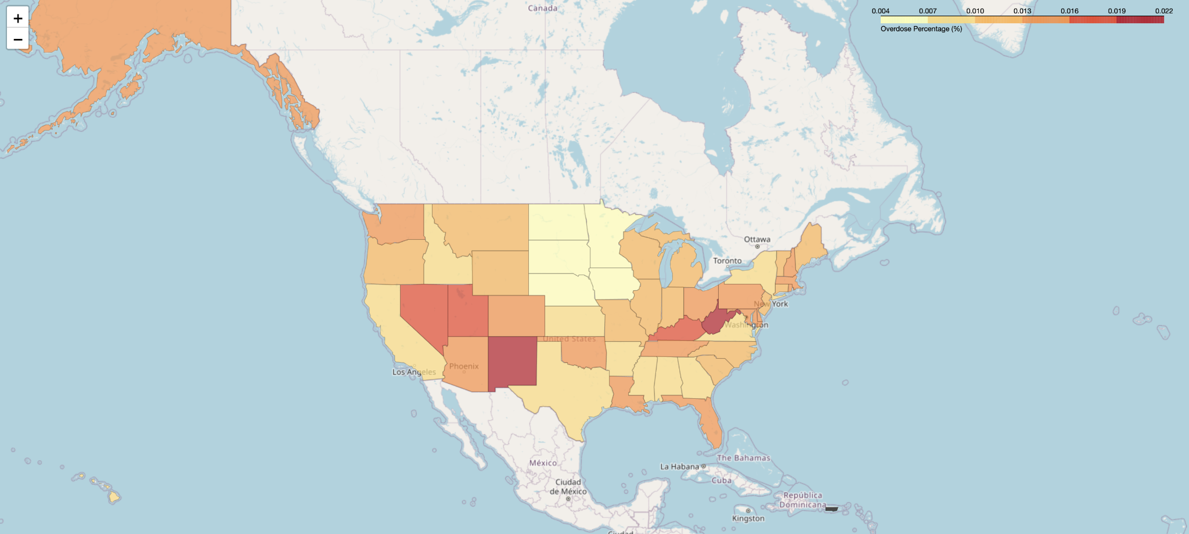
Looking Forward: FHIR + GPT
Notes:
This is just for fun, the extreme of a business use case.
A couple of weekends ago I organized a hackathon at Smile, where we worked on coupling GPT generative transformers with a FHIR. (LLM’s large language models are synonymous with generative transformers. ) What you're looking at here is the output of a prompt where, after we coupled up CHAT GPT to our FHIR system, we asked to see opioid overdoses by state as an interactive heat map on of the US.
The system went away, did the analysis, created this graph and did it all based on that one prompt. I know we're in the nascent days of Large Language Models, but the fact that we could whip up a solution that couples these Chat GPT type systems with FHIR over a couple of days and be able to get these results from a simple English natural language query really portends what the future holds.
If anybody actually wants to see the solution we built, I would love to show it off.

Slide 16
FHIR
FHIR is a standard for exchanging healthcare information electronically
At the core, FHIR defines
a standard data model (Resources)
a common vocabulary (terminologies)
a protocol (programming interface) for accessing and manipulating these Resources (REST)
and privacy foundations
FHIR is open and global
The FHIR community continues to add functionality to further enhance healthcare interop
E.g.: FHIRPath, Smart on FHIR, Subscriptions, Clinical Quality Language (CQL), CDS Hooks, Prior Auth, GraphQL,...
Notes:
We're going to get into the guts of FHIR and how it actually works.
What is FHIR? First and foremost, FHIR is a standard for exchanging healthcare information electronically. It defines a data model. When we talk about open standards, it's really this data model that is the core of FHIR. FHIR breaks up this data model into discrete resources.
Important to FHIR is a common vocabulary. We call this “code sets”, “terminology” and “value sets” are some common synonyms.
The way we access FHIR is through a programming interface that is based on web standards. So every website today uses what's called REST for their API’s and rather than dealing with esoteric protocols, FHIR has embraced this common global standard. FHIR relies heavily on a foundation of privacy. Privacy foundations: Identities, Consent, Audit, Provenance, thoughtfulness for implementations.
FHIR is global and open. There's no such thing as vendor lock-in with FHIR.
The FHIR community is huge; they're very involved and engaged and they continue to create value adding services like a FHIRpath and Smart on FHIR, and clinical quality language we talked about in clinical decision support.

Slide 17
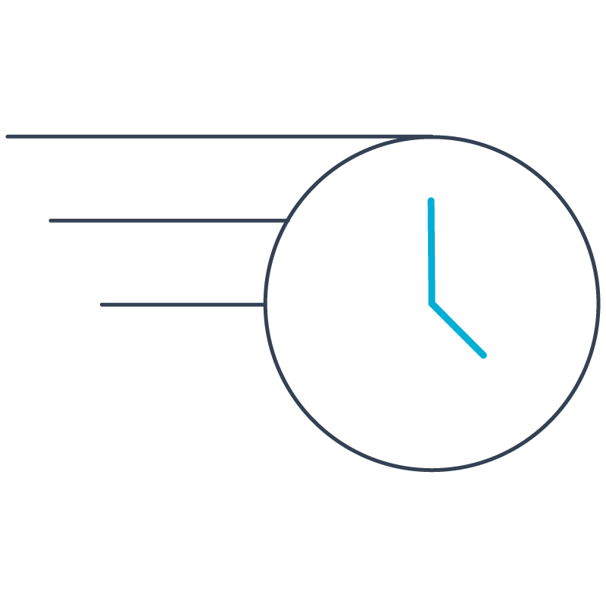
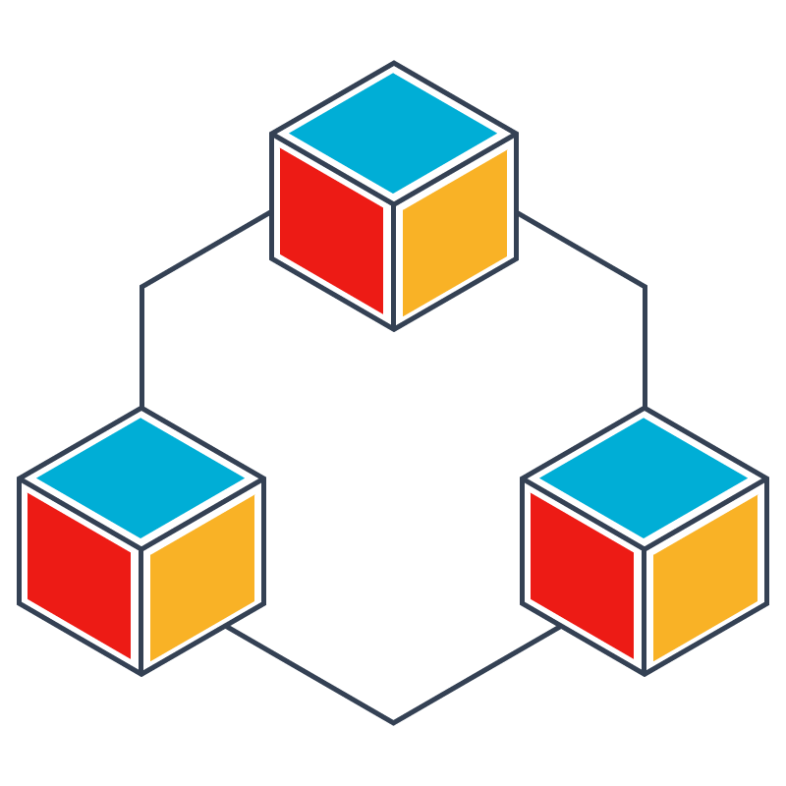
FHIR
Fast
Healthcare
Interoperability
Resources
Notes:
The F in FHIR refers to “fast for implementation.” We want this to be easy to implement. It’s less burdensome to implement FHIR and we do see a number of benefits here.
The H in FHIR refers to healthcare. FHIR is not an industry agnostic standard and because it's specific to healthcare, it allows us to really focus on the unique needs of the healthcare.
THE I in FHIR refers to interoperability. FHIR is, first and foremost, an interoperability protocol.
THE R in FHIR refers to resources. This refers to the same “resources” we hear when we talk about URLs this stands for “universal resource locator”. These are web resources; FHIR uses the same standard as the rest of the Internet.

Slide 18
The 80/20 Rule
FHIR places a heavy emphasis on the 80:20 rule
80% - Specification covers only what is needed by
80% of systems
worldwide
20% - FHIR is easy to extend for specific use cases
Jurisdictions, hospitals with legacy data, specialty medicine,...
Notes:
FHIR places a heavy emphasis on the 80/20 rule. What does that mean? The previous version of HL7 version 3 tried to be everything to everybody, and in doing so it wound up being too cumbersome for anybody.
So FHIR says, what does 80% of the world need? That's what we cover.
We create mechanisms for extending FHIR to support that additional 20 %. That 20% is not built into the core of FHIR, because as we move into those edge cases, the value proposition diminishes, and the complexity goes up.

Slide 19
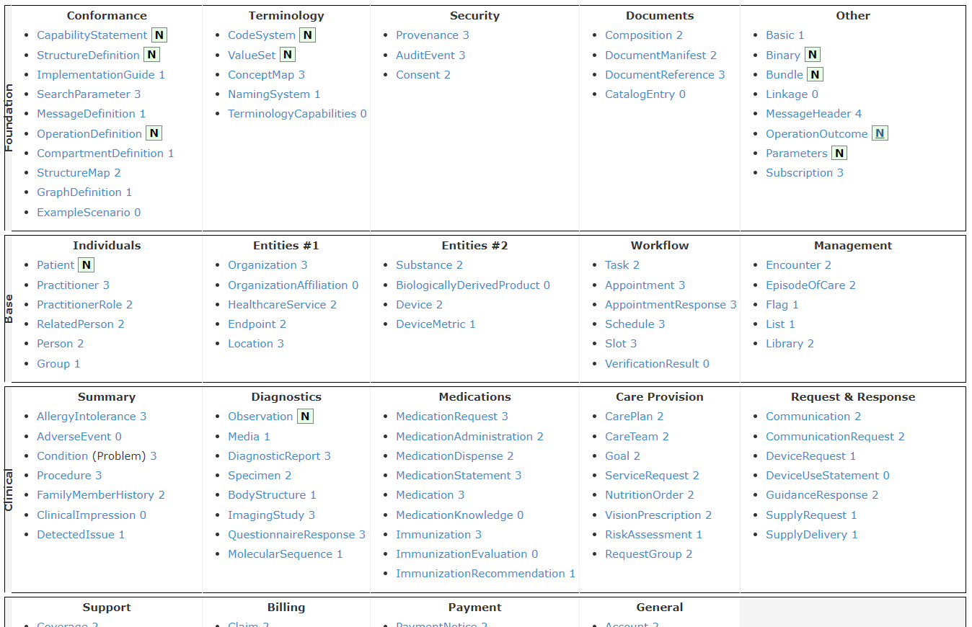
Resources
https://www.hl7.org/fhir/resourcelist.html
145 Resources (in R4)
A Resource [description] describes the structure/ schema of a discrete concept (e.g. Patient)
A Resource [instance] contains the data of interest (e.g. a specific patient’s demographics)
Notes:
Each resource is a mini-schema
The schema represents a well defined use case (e.g. There is a Patient Resource, Encounter Resource, Medications Resource, Claim, etc.)
The schema of a given resource is defined by implementers from around the world and goes through a rigorous lifecycle including multiple rounds of design, discussion, commenting, development, testing, balloting and ratification.
If we look at the second row that on the left side. It says, BASE and under Individuals we see the first resource: Patient. And then some other resources we have are practitioners, groups, organizations.
Moving to the row below, we see our Clinical resources, like allergy/intolerance conditions, observations, etc.
Each of these resources has its own scheme. We can see a number or the letter N to the right of a resource, and that refers to the resource’s maturity.

Slide 20
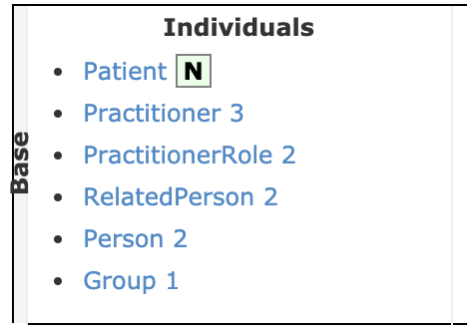
Resources, Maturity Model
Each Resource has a maturity level:
0: Draft
1: + No build warnings
2: + Successfully exchanged/tested between 3 systems (Connectathon)
3: + Verified by work group; formally balloted
4: + Scope tested; formal publication; multiple projects
5: + Published 2+ release cycles; 5+ independent production deployments
N (6): Normative, considered stable
Notes:
http://hl7.org/fhir/versions.html#maturity
We can see the FHIR maturity model. It goes from 0 to 5, and then 6 is represented by the letter n, which means Normative. Anything with a 0 is in draft stage, and I strongly recommend staying away from it. But as we move towards 4, 5, and N and we know that it's reached a point of maturity where any changes to it are going to be increasingly minor.
Once it's normative, then it's considered stable, and you can have confidence that it won't change. It’s neat to look at the path that needs to be taken to progress from one maturity level to another.
The resource needs to be tested and validated in the real world. By the time it does reach a normative state, we have confidence that that it has been tested in the real world. And significantly, if we look at like what goes on in stages4 and 5, it does have a lot of real-world value to it.

Slide 21
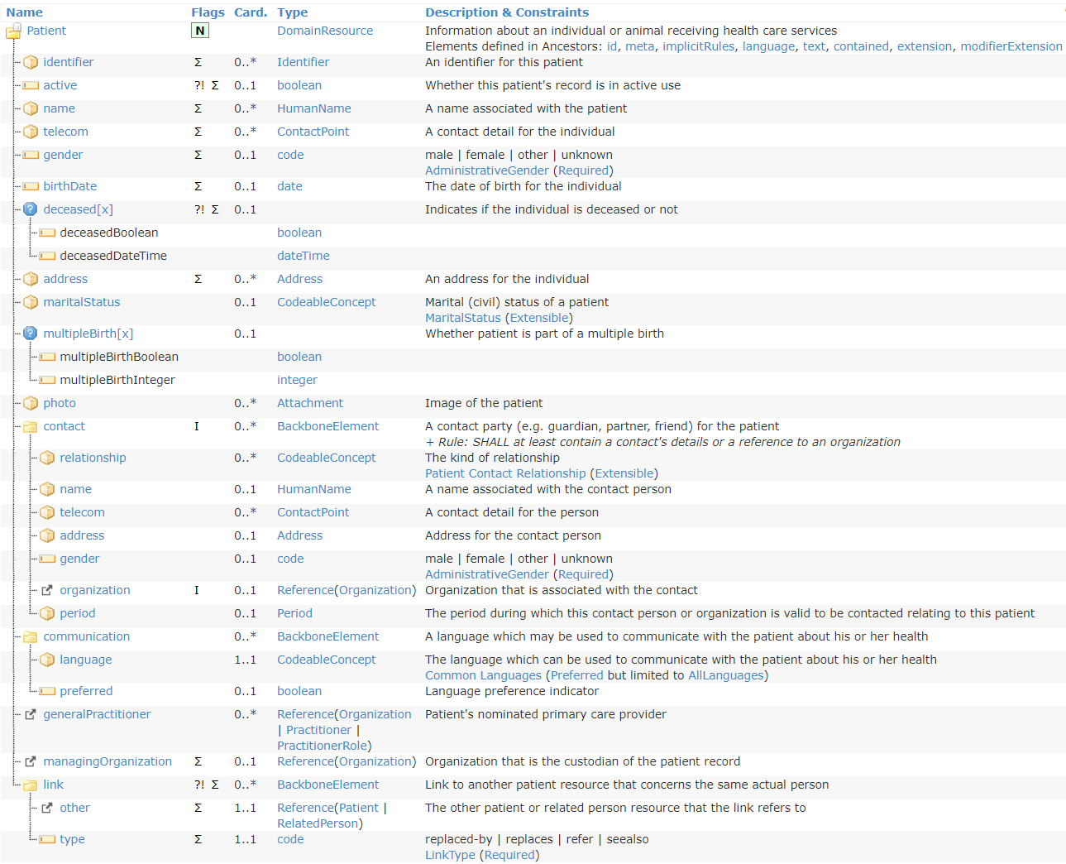
Resources, Structure
https://www.hl7.org/fhir/resourcelist.html
The Patient Structure
Hierarchical (vs. flat)
Expressive data types
80/20 rule
Notes:
http://hl7.org/fhir/versions.html#maturity
Expressive data types:
e.g. Instant is machine described (precise to at least the second), dateTime is human described (variable precision)
Other examples: range, code, url
When you go to resources page and you click on any of those resources, you’ll see this table. This table is the data scheme of the resource.
What we're looking at here is the data schema for the Patient Resource. There is an identifier, we want to know is the patient active or not. We want to know their gender and their birth date and their demographics. This tells us how to understand the format of a FHIR resource.
Moving over to the next column, we’ve got a bunch of flags, and I'm not going to talk about those for today.
The next column over is titled, Card, and that’s short for cardinality. What this is telling us is that these data elements are optional or are mandatory.
That's the or one in the on the left side, and how many times can this element repeat. 1 means there can only be one instance of “is the patient active.” A star means you can have infinite repetition. You can have more instances of a telephone number, as an example.
As we continue to move to the right, we see data types. If you're familiar with traditional programming languages or databases, you'll notice that there's a whole bunch of unique data types in FHIR. FHIR is really expressive around the data types. And this gives us a lot of a lot of capabilities for doing things that we find really hard to do with traditional data standards.
One example is with date. FHIR allows for different types of date standards. One allows for a variability around the precision of date. If I'm not sure of the exact date that someone was born, then we can still put that into a birth date, date type without getting an error that we would see in traditional systems.

Slide 22
Resources, Structure
Element (note: each element links to def’n in data dictionary)
Cardinality
Descriptions & Constraints
Flags
Data Type
Type Icons
Flags
?!: Modifier Element S: Must be Supported Σ: Summary Searches I: Affected by Constraints NE: Cannot have extensions | TU: Trial Use N: Normative D: Draft S: Must Support
Cardinality
Lower and upper bounds on how many occurrences allowed
0.. optional
1.. mandatory
..1 only one occurrence
..✴ can repeat multiple times
Notes:
Summary Slide:
When you go to resources page and you click on any of those resources, you’ll see this table. This table is the data scheme of the resource.
What we're looking at here is the data schema for the Patient Resource.
There is an identifier, we want to know is the patient active or not.
We want to know their gender and their birth date and their demographics.
This tells us how to understand the format of a FHIR resource.
Moving over to the next column, we’ve got a bunch of flags, and I'm not going to talk about those for today.
The next column over is titled, Card, and that’s short for cardinality. What this is telling us is that these data elements are optional or are mandatory.
That's the zero or one in the on the left side, and how many times can this element repeat. 1 means there can only be one instance of “is the patient active.” A star means you can have infinite repetition. You see here you can have more instances of a telephone number, as an example.
As we continue to move to the right, we see data types. If you're familiar with traditional programming languages or databases, you'll notice that there's a whole bunch of unique data types in FHIR. FHIR is really expressive around the data types. And this gives us a lot of a lot of capabilities for doing things that we find really hard to do with traditional data standards.
One example is with date. FHIR allows for different types of date standards. One allows for a variability around the precision of date. If I'm not sure of the exact date that someone was born, then we can still put that into a birth date, date type without getting an error that we would see in traditional systems.

Slide 23
Resources, Structure
Resource
Metadata
Version, Profiles, Tags,...
Any information that didn’t fit in the “80%”
Human readable version of the content (variable but important)
Raw structured data
Extensions
Narrative
Body
Notes:
Let’s take a look at how FHIR resources are structured. We were previously looking at the schema of a patient resource. Now we'll look at how the data is actually stored in a resource.
Resources are composed of 4 elements. Going from the bottom up:
The orange is our body--where all of the content we saw in that patient schema (slides 21/22) would go.
Then we have a narrative, and the narrative is an English description of what's contained in the body. If we're exchanging data with someone who can't read FHIR, they can at least read the narrative and make sense of it.
Extensions are where we go beyond the 80% rule. And this is where we start to address the 20 %.
An example for this might be for eye color to fall within the 20 %. Most health entities don't care about eye color, but if I'm an optometrist, I am going to care about eye color, so I would put eye color into the extensions field.
Finally, we have metadata, metadata contains things such as versions, profiles, tags, etc.

Slide 24
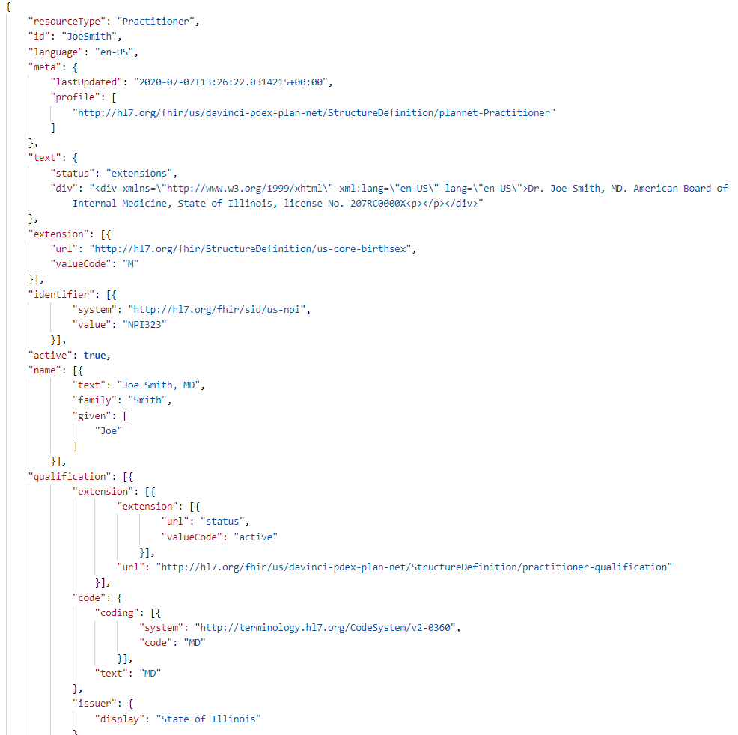
Resources
Metadata (describes the data)
Narrative (human readable)
Extensions (outside the 80%)
Content (body)
Notes:
This is an example of the of the actual content of what a FHIR resource would look like.

Slide 25
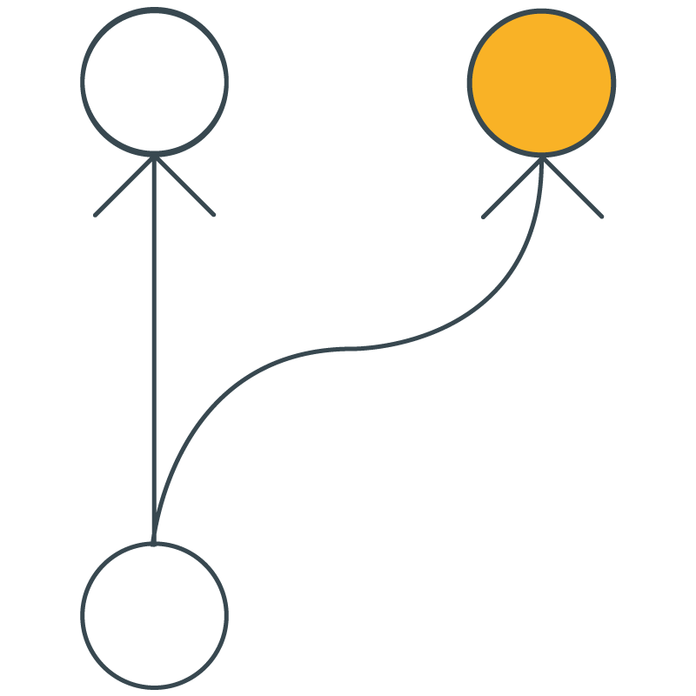
Extensions
Patient Resource does not contain maiden name
So,... include maiden name through an extension
"extension": [
{
"url": "http://hl7.org/fhir/StructureDefinition/patient-mothersMaidenName",
"valueCode": "Williams"
}
]
Notes:
HL7: “Before defining a new extension, attempt to reuse existing extensions defined in one of the shared registries”
Here's an example of an extension. So, for example, maiden name is not included. If we wanted to include maiden name, we could do so.
In this case, in the interest of interoperability, we're not just going to find maiden name for our own system, but there's an actual registry we can go to and see: Has somebody else already defined maiden name, and, if so, let's use their definition, if possible, so that we promote interoperability, and if not-then we'll create our own definition.
You can see here, there's a definition for patient mother's maiden name that we're using.

Slide 26
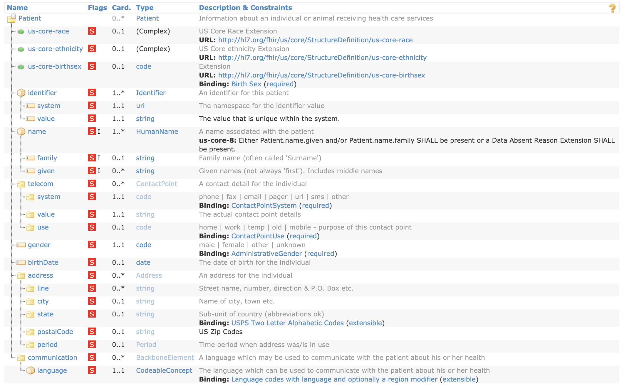
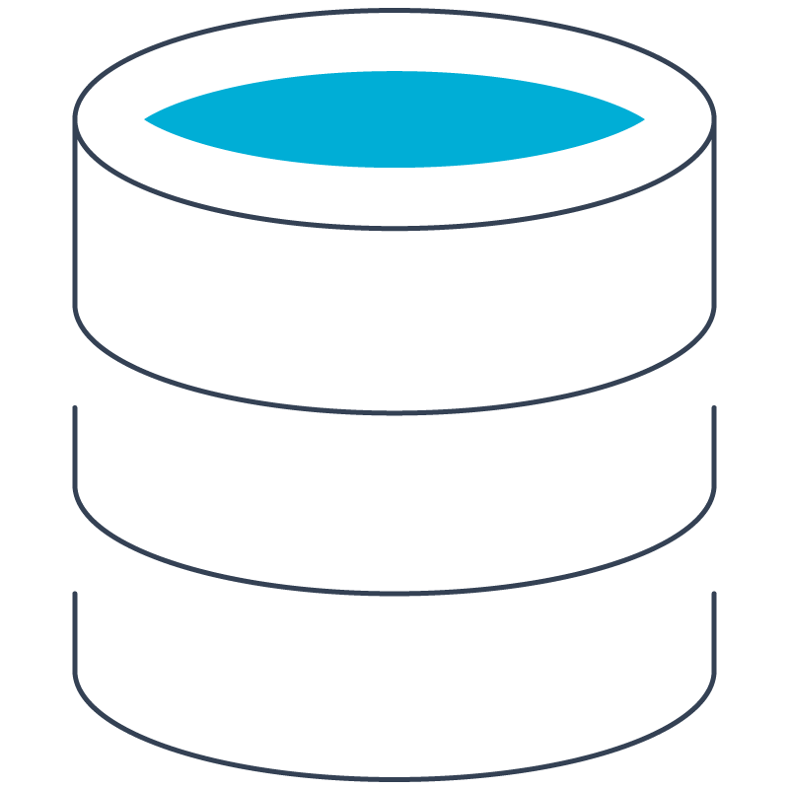
Profiles
A Profile takes the base (vanilla) FHIR Resource and customizes it for a specific use.
The USCDI Patient Resource customizations →
Notes:
Incoming data is validated against the Profile.
We’ve looked at resources, and we've looked at modifying them, and when we modify them, we often call that “constraining the resource”. We can constrain a resource by adding extensions to it by changing the cardinality.
If you recall in our previous example plain vanilla, FHIR resources. Almost all the fields are optional.
In this resource, we have identified a number of resources by the one on the left side as being mandatory. You can see we've added fields, with the green dots at the top, for race ethnicity and birthsex.
Towards the bottom, under address, you'll see as state and postal code have now been constrained to the US: Abbreviations for State and US. Zip codes for the postalCode.
So now that we have constrained the patient resource for a US Context, we call that a profile. It's now profiled for the US.

Slide 27
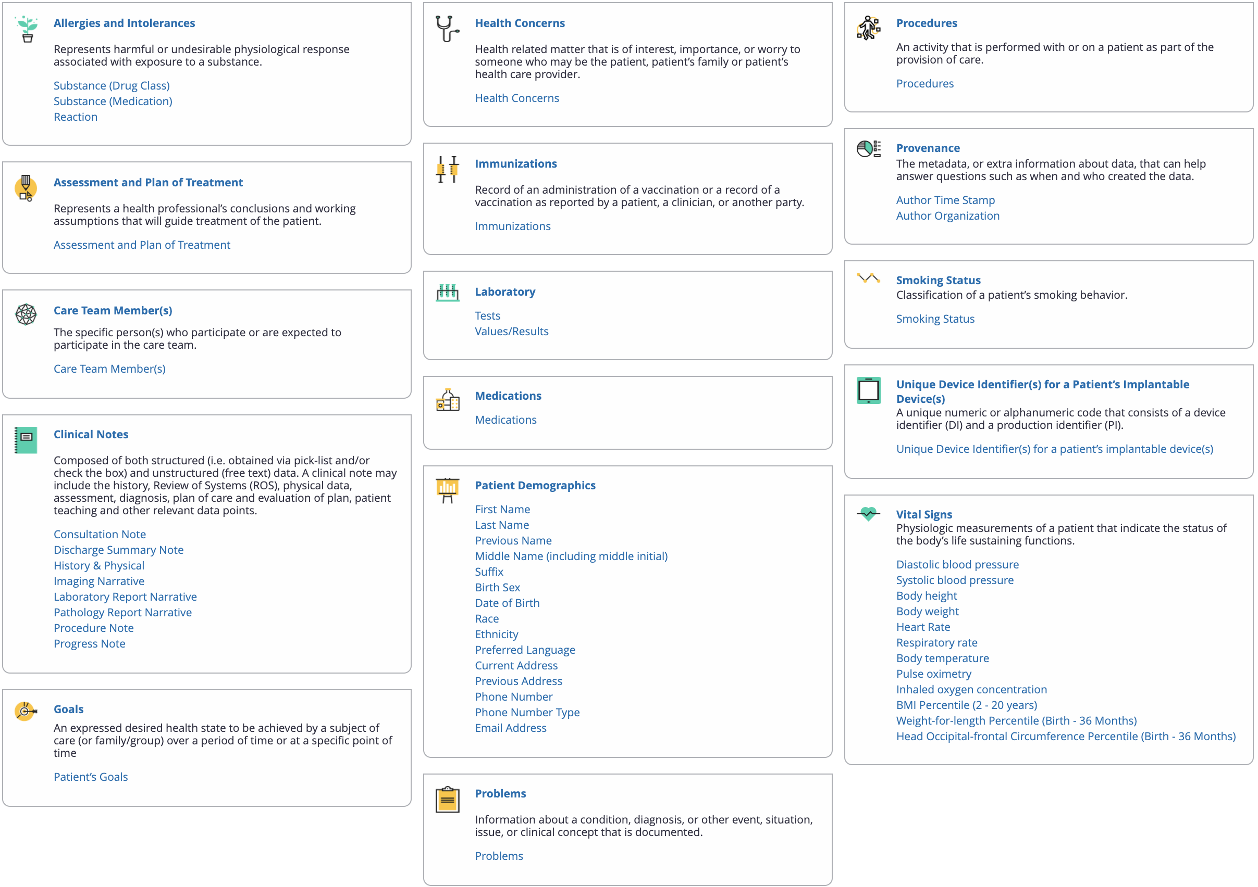
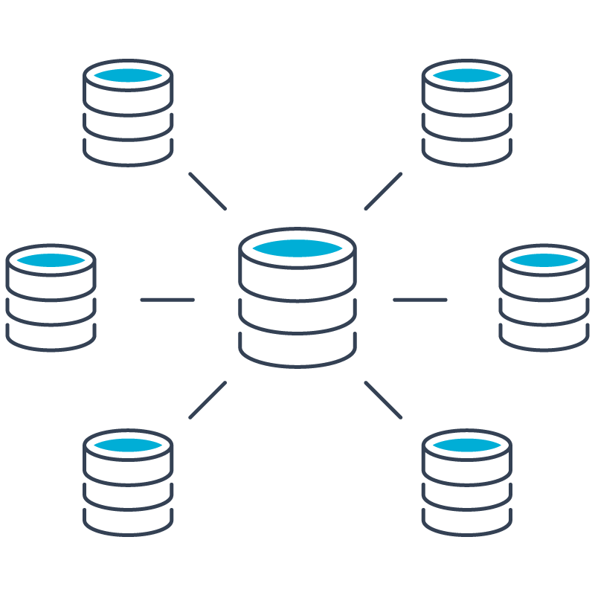
Implementation Guides (IGs)
An IG is a collection of Profiles with supporting documentation
to clarify use.
The USCDI Profile→
Notes:
Bundled in a package containing StructureDefinition, dependencies (e.g. terminology), example resources
See http://packages.fhir.org/ and http://packages2.fhir.org/
We can take a whole bunch of profiles together package them into what we call an implementation guide.
Here is an example of the United States Core Data for Interoperability (USCDI) implementation guide. We can see in the red section, patient demographics. There's a whole bunch of other resources here that have been profiled for the US.

Slide 28
Summary
Implementation Guide
Resource: Generic; global; maturity model
Extension: Data element outside of the 80%
Profile: A Resource customized for specific context
IG: Group of Resources + clarifying documentation
Directions for use
Profile
Profile
Profile
Extension
Resource
Defines Resource, Extension, Profile
Defines IG
Notes:
Bundled in a package containing StructureDefinition, dependencies (e.g. terminology), example resources
See http://packages.fhir.org/ and http://packages2.fhir.org/
To summarize: we start with the familiar resource, the vanilla FHIR resource, we add extensions and we constrain it, and that's called a profile.
We take a collection of these profiles, and we also include directions for use (the directions for use often defines a workflow.) Altogether that makes up an implementation guide.
You'll see on the right side some of the FHIR resources actually define implementation guide and the structure definition. The structure definition defines how a resource is constructed.

Slide 29
Da Vinci Maturity Progression
Notes:
These are some FHIR use cases from the Da Vinci, a consortia of industry players, and they're promoting a number of use cases.
Implementation guides are being built for business value, and you'll recognize cost savings or and efficiencies and automations around them.
Some of them are going to be regulated like burden reduction or prior authorization.

Slide 30
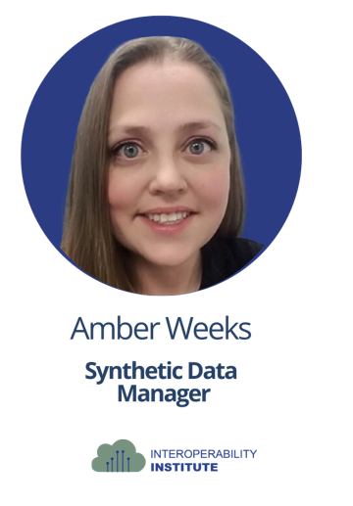
FHIR 101
Notes:
Interested in Playing with FHIR!?
Work with The Interoperability Institute

Slide 31
Open-source healthcare sandbox that supports synthetic and de-identified FHIR® DSTU2, STU3, R4, and R5 data.
Codebase
Users
Communities of Practice
Linux Foundation Managed Project
Open-Source Program Office
Global Development Community
GitHub Code Curation
No cost to users
Building out OS Application Library
Inferno Validator
Expanding offering of synthetic & de-identified data
Reference Implementations build out
Organizations & Individuals coming together to solve a common issue/problem
Sponsored projects that use Meld resources
Governance Autonomy
Public Domain
Private Project
Notes:
The Interoperability Institute is igniting FHIR adoption across healthcare organizations.
We offer the meld sandbox which is populated with synthetic data. It stands on three pillars.
The first pillar is the code base. We're in the process of establishing an Open-Source Program Office. It encourages contributions from the global development community and the code base is curated at Github.
The second pillar is our users. There’s no cost to users for Meld Global. Users can access an open-source application library and use tools such as Infernal validator and clinFHIR
We have an everexpanding offering of synthetic data and de-identified data. We do reference implementation build outs for those profiles and use cases that Adam mentioned.
Our third pillar is the Communities of Practice: bringing organizations and individuals together to solve common problems and issues with sponsored projects that use the Meld resources and data.

Slide 32
Synthetic Data Offerings
Meld Sandbox
Synthetic Data Generator
IOI utilizes a Synthetic Data Generator to create synthetic FHIR data that can be loaded to our sandbox environments. Our synthetic data generator utilizes 200+ disease modules to create relevant clinical and payer resources for testing and validation.
FHIR Personas
Utilizing both our Synthetic Data Generator and Clinical/Payer SMEs, IOI is able to output personas that target specific Use Cases & Workflows. These can be used for targeted testing and validation. IOI creates these Personas for a number of different reasons, including industry needs. These can be loaded in our sandbox environments.
Notes:
Interoperability Institute offers 2 ways we create.
The first is a synthetic data generator, using a module framework in a Monte Carlo simulation, to generate realistic, patient data. But it's not real data. No PHI!
We have over 200 disease modules.
The second way that we offer it is personas, which are bespoke synthetic records. It allows us to tell the story that we want to tell. We create personas curated for use and targeted testing and validation to support various use cases and reference implementations. Those personas are specially handcrafted by our team with direction from customers that are requesting it and align to the profiles for the selected use case or reference implementation.

Slide 33
Meld Demo
Notes:
So how can you use, Meld? You can spin up a MELD sandbox or download the meld open source from gitlab and use it as you need it. https://github.com/Interop-community/meld or
https://kc.interop.community/auth/realms/iol/protocol/openid-connect/auth?response_type=code&client_id=reference-auth&redirect_uri=https%3A%2F%2Fiol2auth.interop.community%2Fsso%2Flogin&state=5de2ffa7-b0f1-42c2-94eb-ea05a7842ee7&login=true&scope=openid
Check out the Meld Demo: https://r0g70e.a2cdn1.secureserver.net/wp-content/uploads/2023/08/Civitas-Short-Meld-Demo.mp4
Join The Interop Community : https://interop.community/
You can HOST or join us at an event, a hackathon or Connectathon.
If you're working on a standards development organization reference implementation, we can help with curating the persona to fit your needs and load it to your sandbox.
We also work with academic partners and our business partners to offer an Intro to FHIR for those without a degree in development/coding. This is a less technical deep dive where we talk about why FHIR was needed, what it is, how it works, and how emerging rules and regulations are driving the interoperability trajectory with FHIR. Ours has a skill building activity portion that uses Meld to help those new to FHIR standards understand how they work and build competencies.
You join the interop community: https://interop.community/
It is free to join members, help, set direction for meld open source enhancements and contribute developers to advance meld functionality and support meld users

Slide 35
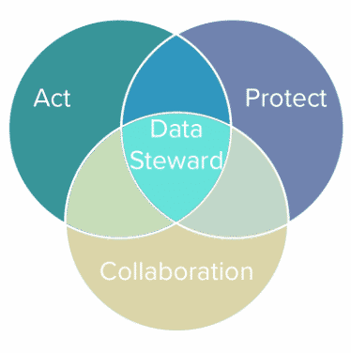
Data for Health; Data for Public Good
How can we support as you enhance patient safety and prevent medical errors?
How can we help you stay ahead of technological advancements and leverage our tech stack to improve healthcare delivery?
How can we help you effectively navigate and adapt to changing healthcare regulations and policies?
How can we help you manage and optimize healthcare data for better decision-making?

Slide 37
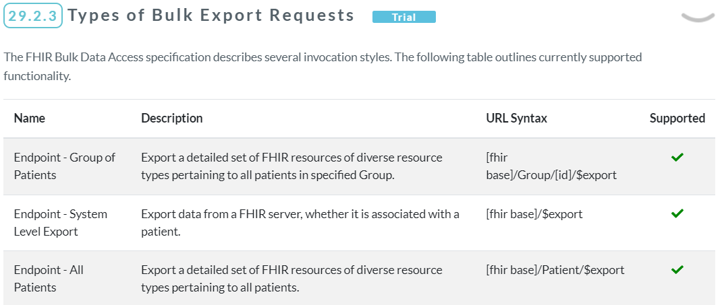
FHIR: State Of The Union
Parameters:
_type: list of resource types
_since: start date/time
_typeFilter: ad hoc filter
_mdm: expands to matched pts etc.

