Slide 1
May 29, 2024

Slide 3
Michigan Health Information Network Shared Services (MiHIN)
MiHIN is Michigan’s state-designated entity to continuously improve healthcare quality, efficiency, and patient safety by promoting secure, electronic exchange of health information. MiHIN represents a growing network of public and private organizations working to overcome data sharing barriers, reduce costs, and ultimately advance the health of Michigan’s population.

Slide 4
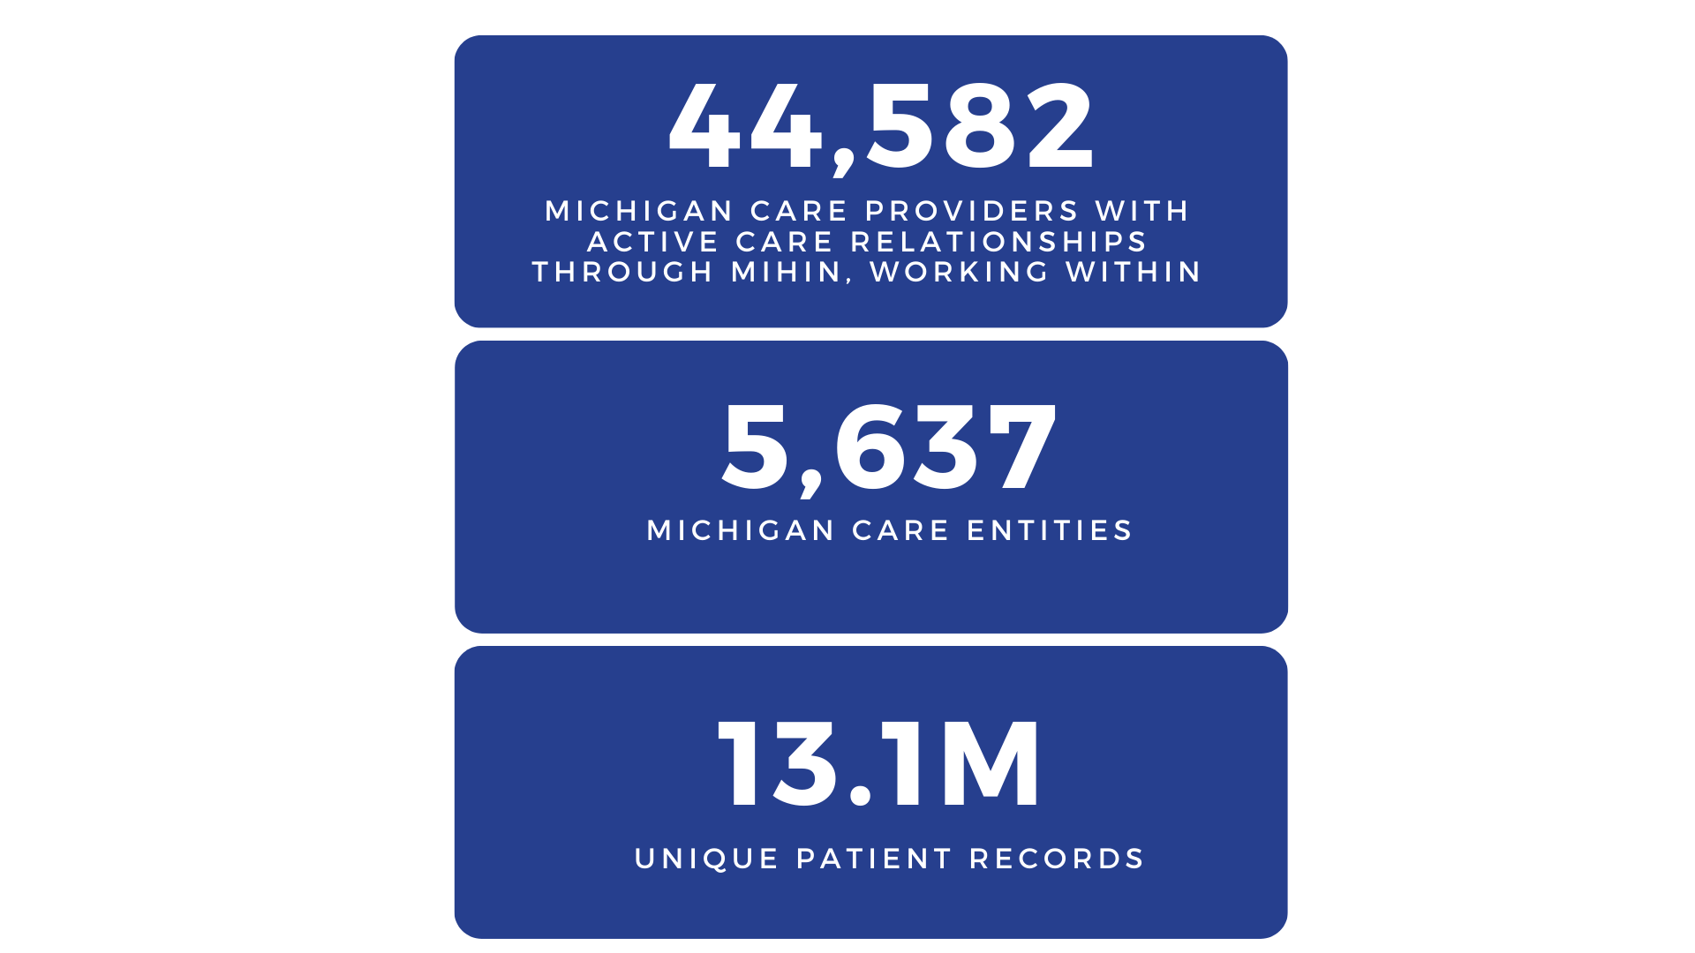
Federal Government
State Government
Health Departments
Health Payers
Health Systems
PIHPs
Hospitals
Clinics
Practices
CMHs
Hospices
FQHCs Pharmacies
Physician Orgs
Physician Hospital Orgs
Doctors
Nurses
Clinicians
Care Managers
Social Workers
Dentists
Pharmacists
Care Seekers

Slide 5
Healthcare Operations
Business & Administrative Activities
Quality Improvement
Compliance
Competency & Training
Payment
Includes any revenue cycle activities
Treatment
Direct patient care
Coordination of care
Consultations
Referrals to other providers

Slide 6
Meeting Agenda
Background & Overview
Defined Value
Exchange Capabilities
Pilot & Guiding Principles
Data Flow & Accessibility
Next Steps to Take

Slide 7
Imaging Network Overview
According to the Office of the National Coordinator for Health Information Technology (ONC), a Health Information Exchange (HIE) “allows health care professionals and patients to appropriately access and securely share a patient’s medical information electronically.” Michigan’s statewide and state designated HIE seeks to enable stakeholders across the health care system to efficiently retrieve diagnostic images across disparate systems and vendors to reduce provider burden, minimize patient exposure to radiation, and lessen healthcare waste due to redundant testing.

Slide 8
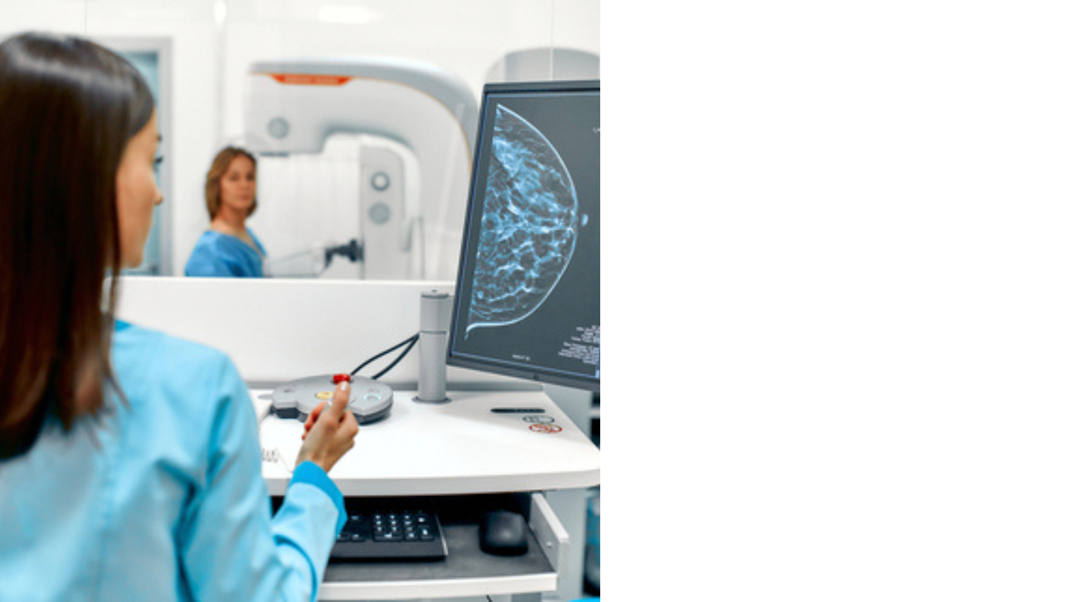
Background & Overview
MiHIN is partnering with MDHHS to develop a statewide imaging enablement solution in response to the white paper generated from the Image stakeholder workshop held in Summer 2021
The white paper outlines the complexities of exchanging radiology images and specific tangible deliverables to reduce imaging duplication, wasteful spending, and radiation exposure to the patient at large.
In alignment with the federal and state legislative imaging policies and the State of Michigan administration’s focus on women’s health, MiHIN has developed a targeted pilot use case for breast cancer imaging exchange, including the identification and exchange of breast tissue density.
During a conversation with a Lead Department Radiologist from one of our largest health systems, it was expressed that substantial areas of improvement for imaging exchange across multiple health systems throughout the state of Michigan exist, and he solidified that starting with a pilot for breast cancer would be beneficial for the patients and communities that we serve.

Slide 9
How does it coalesce?
June 2021, Imaging White Paper Significant Results:
Statewide Imaging Registry
Emergency Department Image Availabilit
Metadata Elements of Image
Image Enablement and Exchange between Disparate Vendors

Slide 10
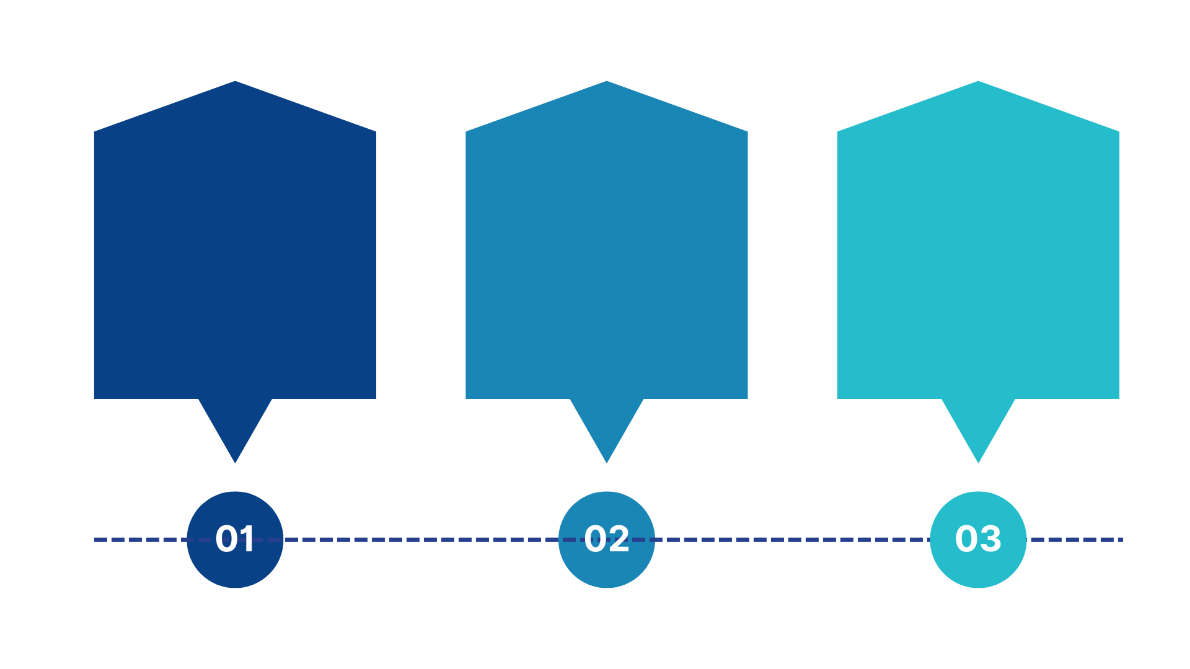
What is MiHIN Doing?
MIHIN has built a proof-of-concept imaging registry for breast cancer imaging studies to allow for the exchange of breast cancer images in a phased approach:
Obtain breast cancer image registry result reports
Allow breast cancer images to be viewable
Allow breast cancer images to be exchanged
Goal to include normalized imaging metadata in the future

Slide 11
Defined Value
Mammograms and Supplementary Screening for High-Risk Populations
Treatment & Operations
Payment
Patient Experience
Visibility to Radiology Report Results
Quality of care improvement
Streamline Imaging Result Reports
Breast Tissue Density availability
Reports available to cover next level of care
Eligibility for coverage in the event of a breast cancer diagnosis
Identify barriers in screening to help lead to earlier detection
Encourage supplementary screening for earlier detection for women with dense breasts
Improve overall quality of care
Notes:
Last 3 years for priors

Slide 12
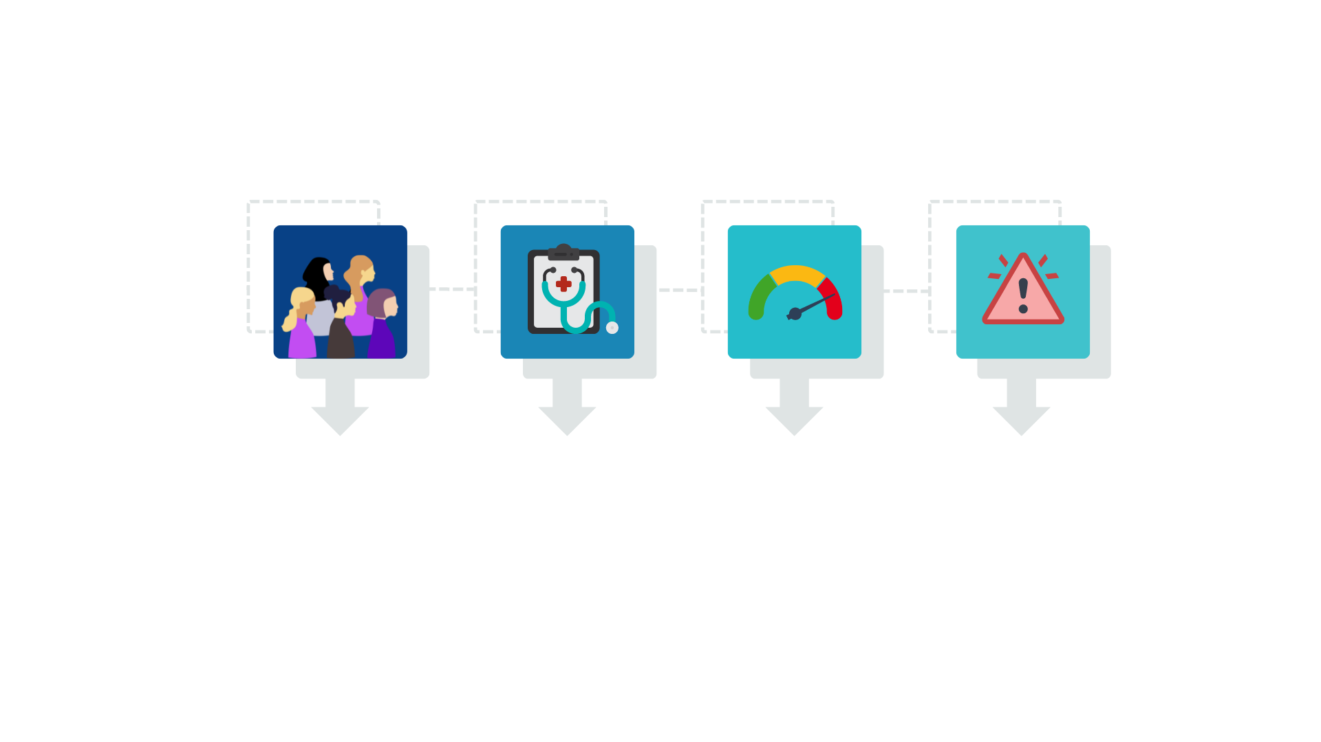
Defined Value - Clinical
Breast Tissue Density: Supporting Facts and Screening Options
40% of women have dense breasts.
Women with dense breast are 4x more likely to develop breast cancer
Dense breast is a higher risk factor than family history
50% of mammograms will miss cancers on Dense breast

Slide 13
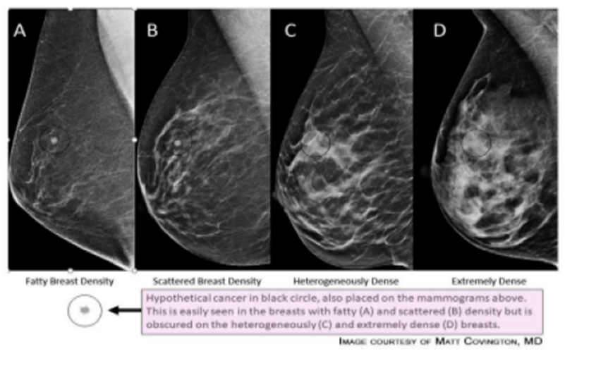
Supporting Facts and Screening Options
Effective June 1, 2015, Michigan law requires that mammography service providers inform patients if they have “dense breast tissue” on screening mammography
Preventative Imaging: Mammogram, 3D Mammogram/Tomosynthesis, Ultrasound, MRI
Many studies have shown 3D mammograms can be more helpful in women with more dense breasts
Full breast screening Ultrasound help detect breast cancers in earlier stages for dense breasts
Breast tissue density will be included on the imaging reports exchanged if included by the sending organization

Slide 14
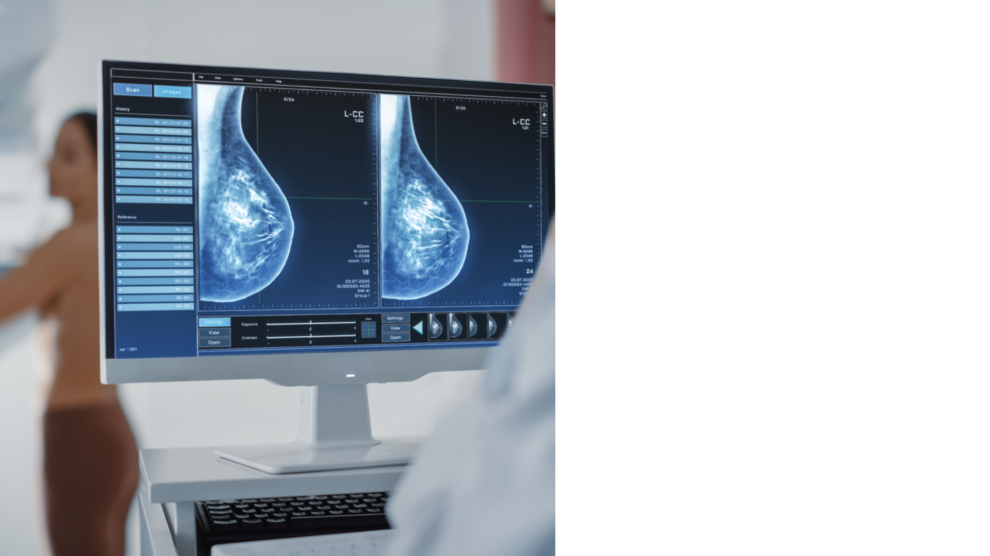
Capabilities of Breast Cancer Imaging Exchange
Pilot solution will allow for prior and present image result reports to be exchanged between the patient care team based on their active care relationship (ACRS).
MiHIN will leverage existing data feeds for radiology result (ORU) messages to:
Identity resolve the patient in the inbound ORU through the common key service
Convert to FHIR and register imaging study in our clinical data repository (CDR)
Make it available in our longitudinal patient viewer
*Future facing proof of concept imaging study will be enriched with additional metadata for future use (examples: anatomical regions, modality).

Slide 15
Initial Pilot Guiding Principles
Outreach and Discussion have been ongoing with the Breast and Cervical Cancer Control Navigation Program (BC3NP) outlining the need to:

Slide 16
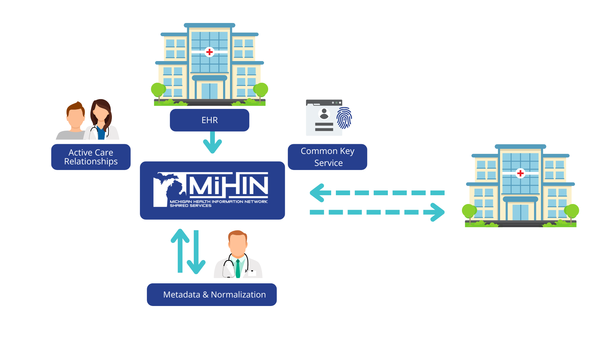
Data Flow: Identify and Retrieve Image Result(s)
Notes:
Not the full image yet

Slide 17
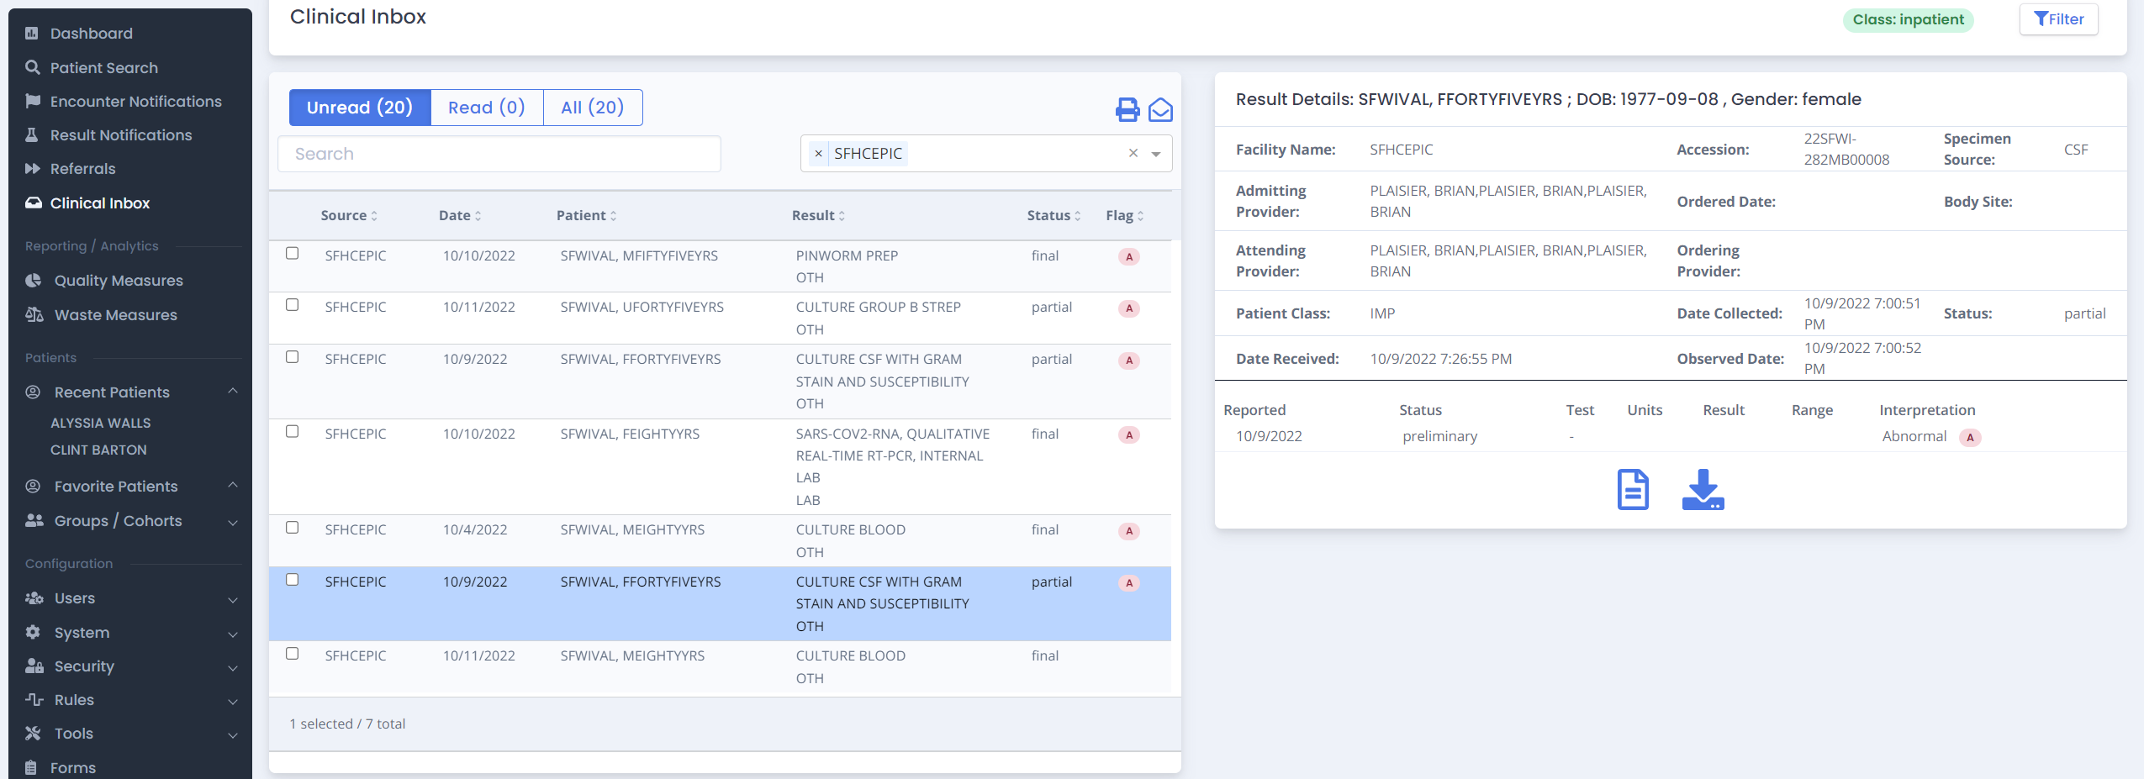
Access via MIGateway
Initial Option for Access
Radiology result reports can be accessed via the longitudinal patient record view in MIGateway
Will show the:
Procedure performed
Sending facility
Discrete results (if available)
Download/view the report
Note: Viewing the diagnostic image is intended to be available in a future phase

Slide 18
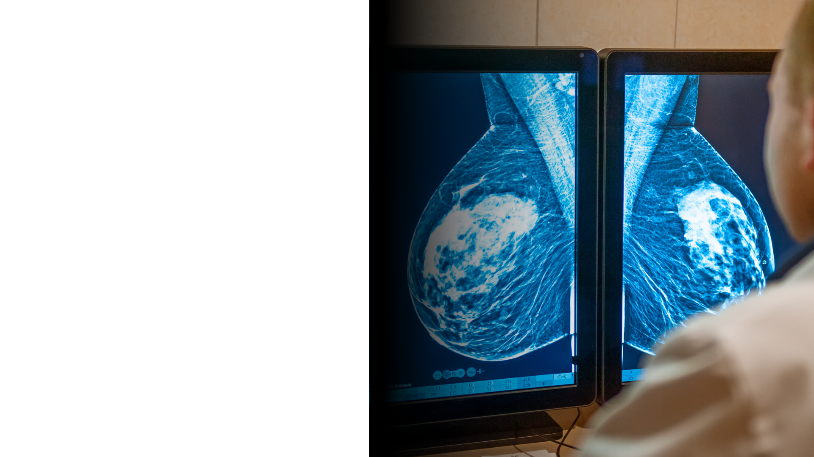
Next Steps for Pilot
What are we looking for ?
Radiology results to be sent from all organizations statewide!
If you are not sending, please reach out to us so that we can onboard your organization and provide this clinical data to the patient care team.
Would your organization be interested in a breast cancer imaging exchange pilot ? We welcome your outreach to get involved!
Seeking to gauge your interest and request your engagement and feedback on this initiative.
Who to contact?
Lisa Nicolaou, Cross Sector Data Sharing Program Director
Lisa.Nicolaou@mihin.org

Slide 20
Future Access Options
Query from EHR using standard Integrating the Healthcare Enterprises (IHE) profiles
MiHIN plans to allow radiology reports to be available for query using standard XCA and XDS IHE profiles
Future phases may include query for the DICOM image using XCA-I / XDS-I
Transfer to Local PACS
MiHIN plans to allow organizations to initiate a transfer of the diagnostic quality DICOM image to send to their local PACS
Transfer can be initiated through a single sign on from the PACS or through MIGateway

Slide 21
Background – Legislative Highlights
Federal legislation
Breast & Cervical Cancer Prevention and Treatment Act, Public Law No: 106-354
Allowed states to offer those who are diagnosed with cancer in NBCCEDP access to treatment through Medicaid; State by State eligibility requirements.
Patient Protection and Affordable Care Act (ACA), Public Law No: 111 - 148
Requires most private group and individual insurance plans, including most employer plans, to cover all services rated by the USPSTF with an “A” or “B” without consumer cost-sharing, as well as preventive services for women recommended by HRSA. Plans must cover the full cost of mammograms starting at age 40, genetic screening for high-risk women, and breast cancer preventive medication for high-risk women under this policy.
FDA requirement, Compliance by September 2024; Amended regulations under Mammography Standards Act (MQSA) of 1992
Requires mammography facilities to notify patients about the density of their breasts. Compliance required by September 10, 2024
State of MI Legislation:
Michigan Density Notification, Act No. 517, Effective June 1, 2015
Requires mammography facilities to notify patients about the density of their breasts but does not require coverage for additional supplemental imaging screening
Notes:
Imaging AUC

