Slide 1
May 29, 2024

Slide 2
Today’s Presenters

Slide 3
Michigan Health Information Network Shared Services (MiHIN)
MiHIN is Michigan’s statewide entity to continuously improve healthcare quality, efficiency, and patient safety by promoting secure, electronic exchange of health information. MiHIN represents a growing network of public and private organizations working to overcome data sharing barriers, reduce costs, and ultimately advance the health of Michigan’s population.

Slide 4
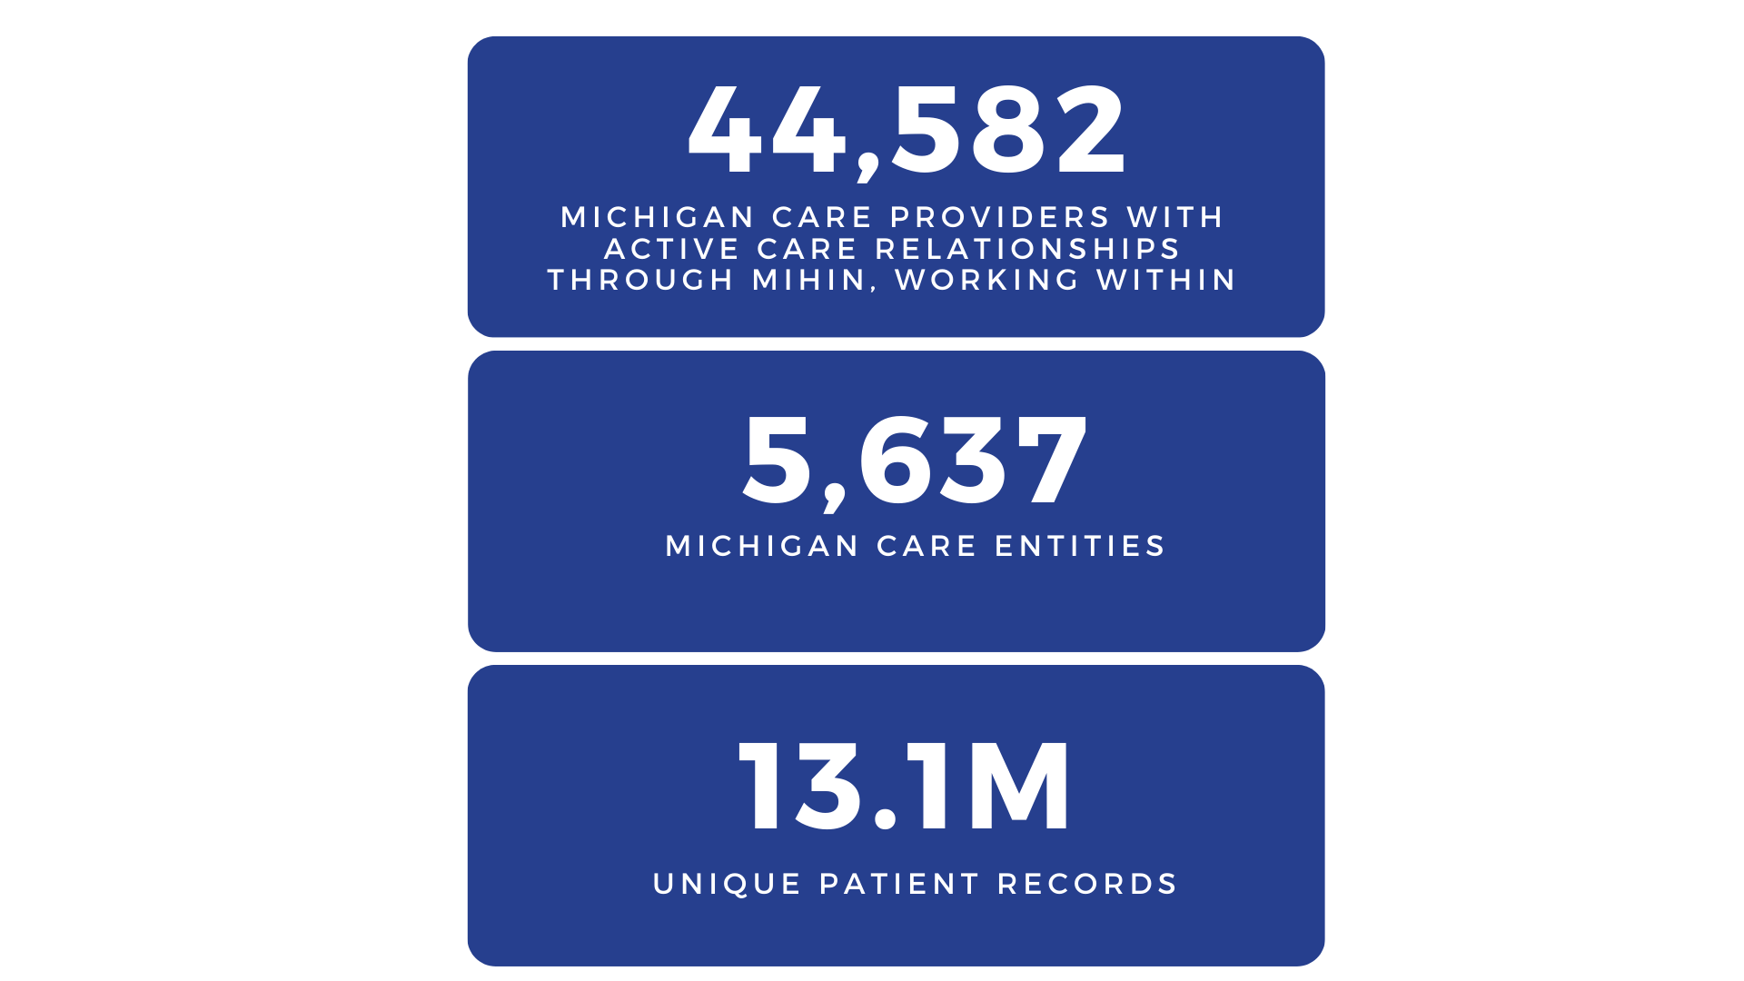
Federal Government
State Government
Health Departments
Health Payers
Health Systems
PIHPs
Hospitals
Clinics
Practices
CMHs
Hospices
FQHCs Pharmacies
Physician Orgs
Physician Hospital Orgs
Doctors
Nurses
Clinicians
Care Managers
Social Workers
Dentists
Pharmacists
Care Seekers

Slide 5
Healthcare Operations
Business & Administrative Activities
Quality Improvement
Compliance
Competency & Training
Payment
Includes any revenue cycle activities
Treatment
Direct patient care
Coordination of care
Consultations
Referrals to other providers

Slide 6
Meeting Agenda
SOGI Data Background
MSHIELD
Civitas/HL7

Slide 7
Sexual Orientation & Gender Identity
Sexual orientation and gender identity (SO/GI) data is demographic information that includes self-reported sexual orientation, gender identity, and sex characteristics. This information can empower providers to understand patient needs and deliver appropriate care, as well as enable researchers, policymakers, and public health professionals to better identify disparities and barriers to care.

Slide 8
Promoting Health Equity Across Michigan
Matthias Kirch, Health Informatics Specialist, MSHIELD

Slide 9
Collaborative Quality Initiatives (CQIs)
CQI Evolution
“Legacy Model”
Specialty Care
“Population Health”
Chronic Disease
“Cross-Cutting”
Consulting
Notes:
What is a CQI? Networks of participating physicians and hospital partners across Michigan with funding and support from BCBSM
Physicians, hospitals, and health systems that participate in CQIs collaborate and share data on patient risk factors, processes of care, and care outcomes to identify best practices and implement quality improvement initiatives
For the past 25 years in Michigan, the Collaborative Quality Initiatives (CQIs) have taken a cooperative bottom-up approach to health care quality improvement. Made up of physician organizations and hospitals around the state and led by local clinicians who set the quality improvement agenda, the CQIs rely on an approach that uses granular data collection, analysis, and transparency to develop and implement practice improvements to support a learning health system. The quality improvement work of the CQIs is administered directly by clinician leaders who direct statewide consortiums of their peers. Each CQI is financially supported by Blue Cross Blue Shield of Michigan. There are currently 23 active CQIs, each of which focuses on a specific clinical specialty or challenge.
CQIs are evolving in ways that align with the factors that drive health inequities; MSHIELD grew out of this evolution
Historically focused heavily on Specialty Care
Have smaller populations that focus on a specific area of specialty care (i.e., bariatric surgery, oncology, emergency medicine, etc.)
Population Health CQIs
Large patient population, with a focus on primary care
Partnering CQIs (MSHIELD)
Unlimited population
Our role is to “consult” with other CQIs to support them in setting goals related to health equity and addressing social health needs
Represents an expansion of traditional CQI model to incorporate community partnerships
MSHIELD’s role = supporting CQIs and their participating providers to integrate strategies that identify health inequities, address social health needs, and work toward more equitable outcomes for all patients.

Slide 10
What We Do
Data Collection & Analysis
MSHIELD is a consulting CQI focused on health equity and the social drivers of health
Anti-
Racism
Social Needs Screening & Linkages
We work with other CQIs, healthcare organizations, and community partners to achieve health equity via 3 main initiatives
Centering Health Equity
Notes:
MSHIELD is a consulting CQI—we work with other CQIs, healthcare organizations, and community partners to achieve equitable health outcomes for all.
Unlimited population
Our role is to “consult” with other CQIs to support them in setting goals related to health equity and addressing social health needs
Represents an expansion of traditional CQI model to addressing population health
Large stakeholder base compared to traditional CQIs: in addition to CQIs and member hospitals/practices, community-based organizations, HIT platforms/organizations, and more!
We provide ongoing guidance to CQIs within these three main initiatives, and I’ll talk about each of these in more depth shortly:
Race/ethnicity stratified analyses
Social needs screening and linkage
Building capacity and a culture of health equity in QI

Slide 11
Collecting Demographic Data Best Practices Guide
This document is meant to serve as a tool to:
evaluate your current program and practices related to data collection,
identify best practices and areas for improvement, and
set goals to implement best practices
Notes:
[Matthias]
A key strategy in promoting health equity is to establish and implement standards for data collection. Data are essential to identify disparities, set priorities, and measure progress. Using best practices in collecting demographic data, such as race, ethnicity, and language (REAL), sexual orientation and gender identity (SOGI), and disability status will yield data that is accurate, reliable, and affirms the identity and experience of patients.
*QR Code to BPGs is also on your table tents
Resource: michiganshield.org/cqi-engagement/best-practices-guides

Slide 12
Sexual Orientation and Gender Identity (SOGI)
Sex/Biological sex: refers to label given at birth, based on genitalia, and genetic factors like chromosomes (e.g., male, female, intersex)
Gender/gender identity: refers to an individual’s sense of their own gender (female/woman/girl, male/man/boy, nonbinary, transgender, gender fluid, etc.)
Sexual orientation: refers to those who you are attracted to physically, emotionally, or romantically (heterosexual/straight, gay, lesbian, bisexual, queer, asexual)
Gender expression: refers to the way a person displays their gender (e.g., masculine, feminine, androgynous)
Notes:
[Matthias]
Collecting information about sexual orientation and gender identity allows for identification of health care disparities faced by patients because of their identity.
We do recommend asking about both of these categories, because there is growing evidence that gender identity and expression, sex at birth, and sexual orientation all influence health outcomes.

Slide 13
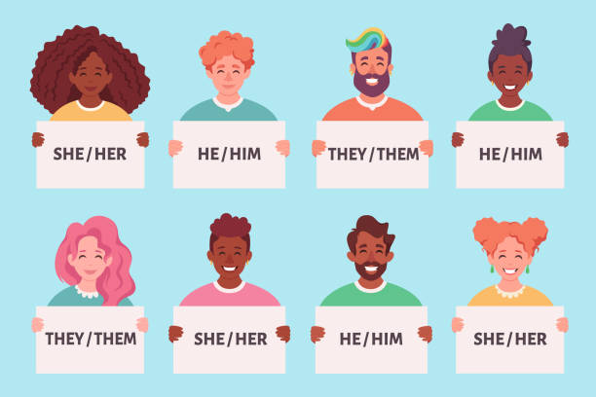
Sexual Orientation and Gender Identity (SOGI)
Pronouns are the words you use to refer to another person (e.g., he, she, them). Asking about pronouns helps other people talk about a person using the correct terms. We do not include pronouns in our list of recommended data to collect, but we encourage health care and social service organizations providing direct care to ask about pronouns and preferred name.

Slide 14
Sexual Orientation and Gender Identity (SOGI)
Considerations
Consider how you will use the information you collect. For example, if you want to know how to refer to a patient, ask about their pronouns.
Offering more categories for gender may cause questions for cisgender people, but it may also signal to transgender and gender fluid people that they are seen and accepted.
What to Ask
Do you think of yourself as:
Asexual
Bisexual
Gay
Heterosexual
Lesbian
Queer
Prefer to self-describe ______​
Prefer not to answer
Which most closely describes your gender? Select all that apply.
Man
Non-binary/Genderqueer
Transgender Man/Trans Male
Transgender Woman/Trans Female
Woman
Prefer to self-describe: _____​_______
Prefer not to answer​
What sex were you assigned at birth, on your original birth certificate?
Female
Male
Something else: ___________________
Prefer not to answer
Notes:
[Matthias]

Slide 15
Best Practices Data Collection
Allow patients to self-identify and self-report
Consider allowing people to check multiple boxes
Consider allowing people to write in answers for each category
Include communities in the design and validation of how questions are asked (i.e., focus groups, surveys, feedback forms).
Validate the data collected
Process in place to confirm with the patient and update at subsequent visits and interactions
Workflow to check that data is available for all patients
Consider
What data do you need to collect?
What will you do with the data?
Notes:
[Matthias]
Some people may feel uncomfortable disclosing information that could be used to discriminate against them. There may be historical distrust of certain institutions such as hospitals or universities.
Some options to address this include:
Utilize a script for staff to read to patients that explains the rationale for data collection.
Designate someone to respond to patient inquiries.

Slide 16
Best Practices Data Coding and Sharing
Include data both for sex assigned at birth and gender using these broad categories
Sex assigned at birth
Female
Male
Consider including Intersex as an option—some birthing sites already do this
Gender
Man
Non-binary
Transgender
Woman
Unknown/not reported
Allow these fields to be multiple selection (e.g. someone can be a woman and transgender, others may identify as only one of those options)
Collect metadata from sites reporting SOGI data. This includes:
Exact question wording
Who collected the data
Response options, including missing options
Include multiple fields to allow for multiple selection
This will take some data infrastructure change
It will allow for more flexible reporting options
Consider
What are your reporting needs?
Is your system flexible to support changing identities?
Notes:
[Matthias]

Slide 17
Our Team
Alyssa Moore
Administrative Specialist
Bradley Iott
Content Expert
Carol Gray
Program Manager
Lindsey Herrel
Program Co-Director
Matthias Kirch
Health Informatics Specialist
Melissa Creary
Program Co-Director
Renu Tipirneni
Program Co-Director
Sheryl Kelly
Equity & Anti-racism Strategist

Slide 18
Thank you!
Contact Us:
Matthias Kirch (he/him)
Email | kirchm@med.umich.edu
Website | www.michiganshield.org
Notes:
Mention that we have a consultation form

Slide 19
Demographic Element Modernization (DEMo) Initiative
Madelynn Valu, MPH, RD
Program Director, Civitas Networks for Health

Slide 20
ABOUT CIVITAS
Civitas Networks for Health is a national collaborative comprised of over 170 member organizations working to use health information exchange, health data, and multi-stakeholder, cross-sector approaches to improve health.
Civitas educates, promotes, and influences both the private sector and policymakers on matters of interoperability, quality, coordination, health equity, and cost-effectiveness of health care. The network supports local health innovators by amplifying their voices at the national level and increasing the exchange of valuable resources, tools, and ideas.
Civitas Networks for Health
@civitas4health
Notes:
Madelynn – Civitas

Slide 21
Health Level Seven® International (HL7®)
Not-for-profit
ANSI-accredited standards development organization (SDO)
Dedicated to providing a comprehensive framework and related standards for the exchange, integration, sharing, and retrieval of electronic health information that supports clinical practice and the management, delivery and evaluation of health services
Vision
A world in which everyone can securely access and use the right health data when and where they need it.
Mission
To provide standards that empower global health data interoperability.
Education on Demand: HL7® training Straight from the Source
Notes:
Becca – HL7

Slide 22
Notes:
Danielle – AHIP

Slide 23
Challenges with Demographic Data Collection
Collection Instruments Lead to Inadequate Data
There are multiple disparate standards for collecting and sharing the data.
Large numbers of “Other” or “Unknown” because no response options for how people identify.
Granular options are often insufficient, inequitably applied, or not applicable or actionable across all regions, states, or local communities.
Language and terminology used may not be culturally appropriate or person-centered.
Response options are not actionable.
Open-ended free text responses hard to aggregate and analyze due to misspellings.
Data are not interoperable.
Patient Burden and Lack of Trust
Stakeholders Must Invest Significant Resources
Notes:
Data standards often do not align across these requirements, across states, across markets (Medicare, Medicaid, commercial), or across stakeholders (payers, providers, health care orgs)
We all are putting in a lot of work to make technical changes to systems, train staff, develop materials for respondents so that we EACH can collect this data to meet our specific requirements...
But not getting accurate, complete, or actionable data
Lack of data collection infrastructure, interoperability, and alignment impedes collaboration & presents challenges to properly aggregate, analyze, and enable apples to apples comparisons

Slide 24
Goal of DEMo Initiative
Modernize and enhance national demographic data content and exchange standards so that they are culturally sensitive, sufficiently granular, and aligned across stakeholders to permit the collection of accurate, complete, comparable, actionable, and interoperable data that supports better outcomes, fewer disparities, improved patient trust, and enhanced operational efficiency.
Notes:
Danielle – AHIP (cover "how")
We all share the common goal of reducing disparities in care
We all understand the importance of self-reported demographic data to better inform culturally and linguistically appropriate care and to identify and act on disparities
All have collective responsibility for this data: collecting it, storing it, protecting it, measuring, analyzing, acting on it
We all are increasingly being required to collect this data as part of federal or state regulations and/or accreditation requirements

Slide 25
Stakeholder Involvement
Accrediting Organizations
Payers
Healthcare Ecosystem
Standards Development Organizations
Academia
Community Based Organizations
Vendors
Hospitals
Patients
Government
Pharmacies
Providers
Public Health
Manufacturers
Notes:
Danielle - AHIP
AHIP:
Saw a need that required action
Staff have expertise in developing evidence-based and consensus-driven data standards (e.g., PRAPARE) and in bringing diverse stakeholders together for alignment (e.g., CQMC)
Tried to be as thoughtful as possible in our approach (spent 3+ years on this work to date)
Didn't start from scratch—looked to existing standards and then humbly listened to different stakeholders and perspectives
Doing our best to convene and reach consensus
Civitas and HL7 have technical capabilities and relationships to develop interoperable exchange standards and shepherd through appropriate processes
Difference between this work and similar work like SIREN's Gravity Project:
Focused on personal characteristics rather than social risks and needs
Nothing collected with these demographic data need to be "addressed"
More to inform care and services

Slide 26
Phases of Work
Phase 1:
Align & Inform
Phase 2:
Scope & Build Consensus
Phase 3: Implement & Integrate
1. Align Data Elements
Race and Ethnicity
Sexual Orientation & Gender
Disability Status
Language Preference
Military Experience
Spirituality
*Conduct cognitive testing.
2. Build Consensus on Tech Standards
Utilize HL7 standards development process.
Explore the development and publication of new FHIR Questionnaire representing the recommended data elements developed in Phase 1.
Explore creation of corresponding HL7 Implementation Guides (IGs).
3. Pilot
Curate existing materials and prioritize development of future materials for putting standards into practice.
Notes:
Madelynn – Civitas

Slide 27
Pronouns, Sexual Orientation, Sex, Gender

Slide 28
Introduction and Definitions for Pronouns
Thank you for taking the time to answer these questions. To make sure we are communicating with you respectfully, the following question will ask you to choose or write-in your pronouns. Pronouns are how you identify yourself apart from your name and how someone refers to you in conversation. We recognize that this is a personal question, and responses may change overtime. This is an optional question, and your care will NOT be affected in any way should you choose not to respond.

Slide 29
Proposed Optional: Pronouns
Pronouns
We would like to be respectful. What pronouns do you use to identify yourself? (Select all that apply) He, him, his She, her, hers They, them, theirs Ze, hir, hirs Ze, zir, zirs Additional pronouns, please specify: ____ I don’t know I choose not to respond
Adapted from Fenway Health’s National LGBTQIA+ Education Center

Slide 30
Revised Optional: Pronouns
Pronouns
We would like to be respectful. What pronouns do you use to identify yourself? (Select all that apply) He, him, his (for someone who might identify as a male) She, her, hers (for someone who might identify as a female) They, them, theirs (non-binary, for someone who might identify as neither male or female, can be used in singular form) Ze, hir, hirs (non-binary, noun-self pronoun, often used by people who do not identify as either male nor female) Ze, zir, zirs (non-binary, noun-self pronoun, often used by people who do not identify as either male nor female) Additional pronouns, Something else, please specify: ____ Use my name I don’t know I choose not to respond at this time
Notes:
Considerations Included:
Include “at this time” after “I choose not to respond”. “I choose not to respond” may not accurately represent how someone feels.
Include an option for “Use my name”.
Remove “Additional pronouns” as this may indicate that an individual has to come up with other pronouns.
Define pronouns
Sources: https://www.broads-authority.gov.uk/about-us/gender-pronouns#:~:text=He%2Fhim%2Fhis%20(for,when%20referring%20to%20multiple%20people).
https://www.nytimes.com/2021/04/08/style/neopronouns-nonbinary-explainer.html
https://www.hhs.nd.gov/sites/www/files/documents/DOH%20Legacy/Pronouns.pdf
Considerations Not Included:
Consider not asking about pronouns as there is question of if this is a demographic characteristic or not.
Rationale: Pronouns are generally considered to be a demographic characteristic.
Source: https://www.ncbi.nlm.nih.gov/pmc/articles/PMC9125176/#:~:text=For%20participants%20who%20identified%20as,include%20clarity%20about%20gender%20pronouns

Slide 31
Introduction and Definitions for Sexual Orientation, Sex, and Gender
Thank you for taking the time to answer these questions. The following questions will ask you how you think of yourself regarding your sexual orientation, sex, and gender. Sexual orientation means which gender you have an emotional, romantic or sexual attraction to. Sex means the sex you were assigned at birth by a doctor or midwife, based on external body parts. Gender is one's own sense of self and their gender, whether that is man, woman, neither or both. Your gender may differ from your sex assigned at birth. We recognize that these are personal questions and responses may change overtime. Your care will NOT be affected in any way should you choose not to respond.

Slide 32
Proposed: Sexual Orientation
Sexual Orientation
Do you think of yourself as (check all that apply): Gay or lesbian (predominantly attracted to the same gender as your own) Straight or heterosexual (predominantly attracted to gender different from your own) Bisexual (attracted to same gender as your own and gender different from your own) Pansexual (attracted to any gender) Asexual (little or no attraction to any gender) Something else, please specify: _________ I don’t know I choose not to respond
Adapted from Fenway Health’s National LBTQIA+ Education Center. Largely aligns with USCDI. Some state BRFSS have similar questions as of 2018 and 2016 (CA and GA) but others do not (ND).

Slide 33
Revised: Sexual Orientation
Sexual Orientation
At this time, do you think of yourself as (select one check all that apply): Gay or lesbian (predominantly attracted to the same gender as your own) Straight or heterosexual (predominantly attracted to gender different from your own) Bisexual (attracted to same gender as your own and gender different from your own) Pansexual (attracted to any gender) Asexual (little or no attraction to any gender) Something else, please specify: _________ I don’t know I choose not to respond at this time
Notes:
Considerations Included:
Remove the word “predominantly” from gay or lesbian and straight or heterosexual as the word does not appear in the parentheticals for the other options.
Change from “select all that apply” – this was meant to indicate that we recognize the answer to this question is fluid and may change multiple times. To accommodate for this, “at this time” was added to the beginning of the question, while also recognizing that this question should be asked somewhat frequently.
Include “at this time” after “I choose not to respond” as responses could change over time and “I choose not to respond” may not accurately represent how someone feels.
Considerations Not Included:
Separate gay and lesbian.
Rationale: Gay does not just refer to men. Men, women and non-binary people may use this term to describe themselves.

Slide 34
Proposed: Sex and Gender
Sex
What sex were you assigned at birth on your original birth certificate? (Select one) Male, Man Female, Woman Intersex I choose not to respond Optional: What is your legal sex? (Select one) Male, Man Female, Woman Additional sex category, please specify: ____ I choose not to respond While we recognize a number of genders, many legal entities unfortunately do not yet. Please be aware that the name & sex you have previously listed on your insurance must be used on documents pertaining to insurance, billing, & correspondence. If your preferred name and pronouns are different from these, please let us know so that we can update our system.
Gender
What is your gender? (Select one): Male, Man Female, Woman Transgender Male, Trans Man Transgender Female, Trans Woman Non-Binary, neither exclusively male nor female Additional gender category, please specify: I don’t know I choose not to respond
Adapted from USCDI v3.

Slide 35
Revised: Sex and Gender
Sex
What sex were you assigned at birth on your original birth certificate? (Sex assigned at birth is the sex (male, female or intersex) that a doctor or midwife uses to describe a child at birth based on their external body parts. Select one) Male, Man Female, Woman Intersex I choose not to respond at this time I don't know Optional: What is your legal sex? (Select one) Male, Man Female, Woman Additional sex category, please specify: ____ I choose not to respond While we recognize a number of genders, many legal entities unfortunately do not yet. Please be aware that the name & sex you have previously listed on your insurance must be used on documents pertaining to insurance, billing, & correspondence. If your preferred name and pronouns are different from these, please let us know so that we can update our system.
Gender
What is your gender? (Select one): Male, Man Female, Woman Transgender Male, Trans Man Transgender Female, Trans Woman Non-Binary, neither exclusively male nor female Gender Fluid (non-fixed gender identity that may change overtime) Two Spirit (a person who has both a masculine and feminine spirit, traditionally used in Native American/Alaskan Native communities) Additional gender category, please specify: I don’t know I choose not to respond at this time
Notes:
Considerations Included:
Include “at this time” after “I choose not to respond”. “I choose not to respond” may not accurately represent how someone feels.
Add an “Unknown” option to sex assigned at birth.
Keep the question on sex assigned at birth as this may be critical to health care delivery.
Remove the question on legal sex - it implies there could be “illegal” sex and therefore it could be removed. It is an intimidating question and can be confusing for many.
List “Gender Fluid, non-fixed gender identity that may change overtime” as an option under Gender.
Include “Two-Spirit” as a response under Gender. This is similar to “Non-Binary” for Native American communities.
Include lay language on what is meant by “sex assigned at birth”.
Considerations Not Included:
Change "Gender" to "Gender Identity"
Rationale: AHIP heard from members of the community that by using the term " identity" it can come across as this being all in one's head.
Include terms that are being reclaimed by the communities they represent – “Transsexual” was stigmatized in the past but has recently been reclaimed.
Rationale: “Transsexual” is a more specific term that fits under the transgender umbrella. This word can be contentious and shouldn’t be used unless someone specifically asks to be referred to this way.
Source: https://www.healthline.com/health/transgender/difference-between-transgender-and-transsexual
Include “Queer” as an option under Gender.
Rationale: “Queer” is a term people often use to express a spectrum of identities and orientations that are counter to the mainstream. Queer is often used as a catch-all to include many people, including those who do not identify as exclusively straight and/or folks who have non-binary or gender-expansive identities.
Source: https://www.hrc.org/resources/glossary-of-terms

Slide 36
Next Steps
Complete Cognitive Testing with Patient Advocate Foundation (PAF)
Publish Whitepaper and Hold Public Launch – Anticipated for July or October 2024
Move to Phase 2 and HL7 Process
Please see the Civitas Programs Page for Materials and Up-to-Date Information!
https://www.civitasforhealth.org/demographic-data-standards/

Slide 38
Bridging Data & Doing: October 15-17, 2024, in Detroit

