Slide 1
October 29, 2024

Slide 2
Michigan Health Information Network Shared Services (MiHIN)
MiHIN is a non-profit organization that provides technology and services to connect disparate sectors to securely, legally, technically and privately share health information.
An unbiased data trustee, MiHIN does not provide health care services or produce health care data.
Instead, we help convene to share vital health information to advance care, better outcomes and lower costs.

Slide 3
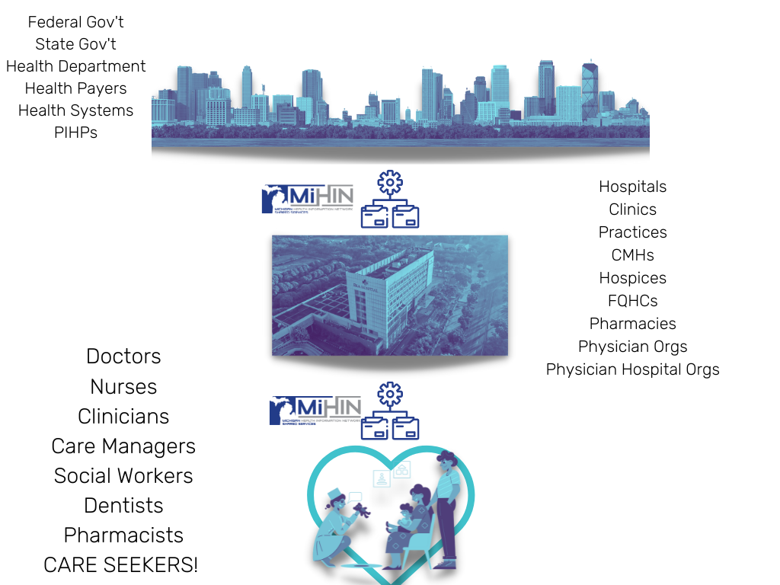
44,582
Michigan care providers with
Active Care Relationships®
through MiHIN, working within
5,637
Michigan care entities
13.1M
Unique Patient Records

Slide 4
Substance Use Prevention Month
Inspire action by sharing how prevention is improving lives in communities across our nation
Unprecedented activity at the state level in recent years to identify and use data sources to better understand and address state and local needs to prevent substance use disorder (SUD), reduce the harms caused by SUD, and promote treatment and recovery.

Slide 5
Data Exchange to improve substance use prevention, treatment and recovery outcomes
Track SUD trends and assess policy impacts.
Identify high-risk populations
Optimizing intervention strategies.
Informed Policy Decisions
Resource Allocation
Outcome Tracking.

Slide 6
Consent is essential in data exchange for improving substance use prevention
Respects patient privacy while enabling effective information sharing.
Consent frameworks allow individuals to authorize sharing their health data across providers and support systems, fostering trust and compliance with privacy laws.
Ensures that providers can access the necessary information for coordinated care, track treatment outcomes, and identify trends, all of which contribute to more targeted and responsive SUD prevention and treatment efforts.

Slide 7
The Download:
Electronic Consent Management Service
Substance Use Prevention Month
Van Ly
Product Owner | van.ly@mihin.org

Slide 8
Current State of SUD Data: Understanding the prevalence and impact of SUDs in Michigan
Addressing Quality, Cost, and Community Impact: Exploring the challenges and opportunities for improving SUD care
Emerging Trends and Initiatives: Examining innovative approaches to SUD prevention and treatment
The Role of HIEs: How MiHIN's eCMS can support SUD prevention, treatment, and outcomes

Slide 9
National Institute of Mental Health
“Substance use disorder (SUD) is a treatable mental disorder that affects a person’s brain and behavior, leading to their inability to control their use of substances like legal or illegal drugs, alcohol, or medications. Symptoms can be moderate to severe, with addiction being the most severe form of SUD.”
“When someone has a SUD and another mental health disorder, it is usually better to treat them at the same time rather than separately.”
“It also is essential that the provider tailor treatment, which may include behavioral therapies and medications, to an individual’s specific combination of disorders and symptoms. It should also take into account the person’s age, the misused substance, and the specific mental disorder(s).”
Source: National Institute of Mental Health, https://www.nimh.nih.gov/health/topics/substance-use-and-mental-health#:~:text=Substance%20use%20disorder%20(SUD)%20is,most%20severe%20form%20of%20SUD.

Slide 10
National Institute of Mental Health
“Substance use disorder (SUD) is a treatable mental disorder that affects a person’s brain and behavior, leading to their inability to control their use of substances like legal or illegal drugs, alcohol, or medications. Symptoms can be moderate to severe, with addiction being the most severe form of SUD.”
“When someone has a SUD and another mental health disorder, it is usually better to treat them at the same time rather than separately.”
“It also is essential that the provider tailor treatment, which may include behavioral therapies and medications, to an individual’s specific combination of disorders and symptoms. It should also take into account the person’s age, the misused substance, and the specific mental disorder(s).”
In 2022, 48.7 million people aged 12 or older had a substance use disorder (SUD) in the past year, including 29.5 million who had an alcohol use disorder (AUD), 27.2 million who had a drug use disorder (DUD), and 8.0 million people who had both an AUD and a DUD
Source: Substance Abuse and Mental Health Services Administration, https://www.samhsa.gov/newsroom/press-announcements/20231113/hhs-samhsa-release-2022-nsduh-data#:~:text=In%202022%2C%2048.7%20million%20people,an%20AUD%20and%20a%20DUD.

Slide 11
U.S. Government Spending, FYTD 2024 1. Health and Human Services 2. Social Security Administration 3. Department of Treasury 4. Department of Defense 5. Department of Veteran Affairs In total, the US has spent $6.29T
26%, $1.62T
22%, $1.40T
20%, $1.26T
12%, $754B
5%, $309B
Source: US Treasury, https://fiscaldata.treasury.gov/americas-finance-guide/federal-spending/

Slide 12
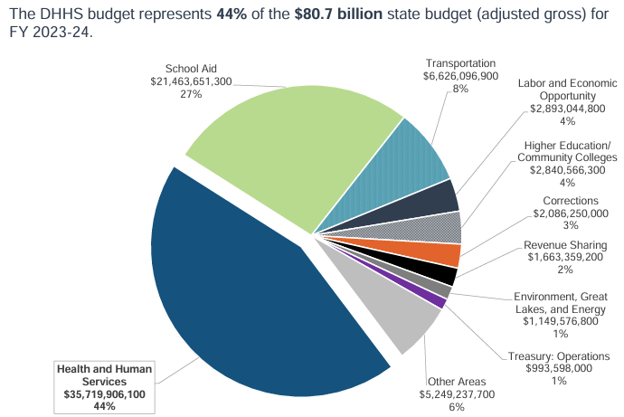
Source: MDHHS, https://www.house.mi.gov/hfa/PDF/Briefings/HHS_Overview_BudgetBriefing_fy23-24.pdf

Slide 13
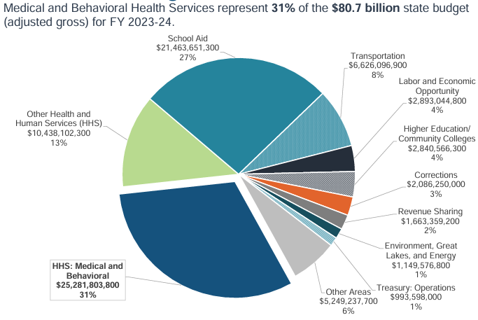
Source: MDHHS, https://www.house.mi.gov/hfa/PDF/Briefings/HHS_Overview_BudgetBriefing_fy23-24.pdf

Slide 14
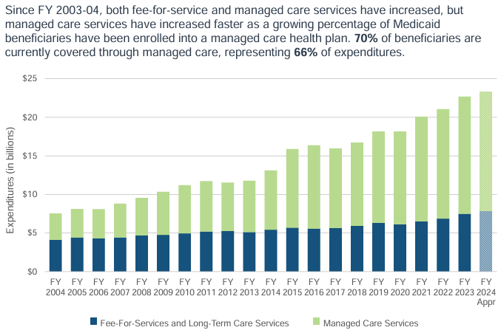
Source: MDHHS, https://www.house.mi.gov/hfa/PDF/Briefings/HHS_Overview_BudgetBriefing_fy23-24.pdf

Slide 15
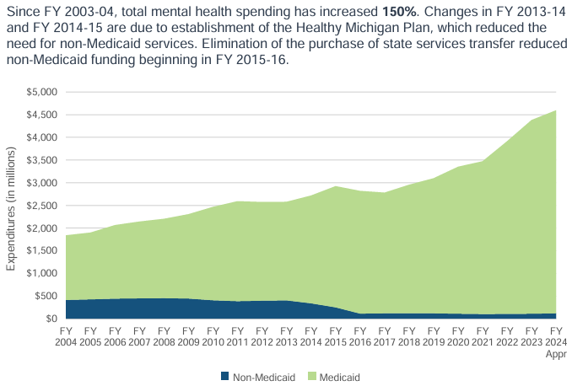
Source: MDHHS, https://www.house.mi.gov/hfa/PDF/Briefings/HHS_Overview_BudgetBriefing_fy23-24.pdf

Slide 16
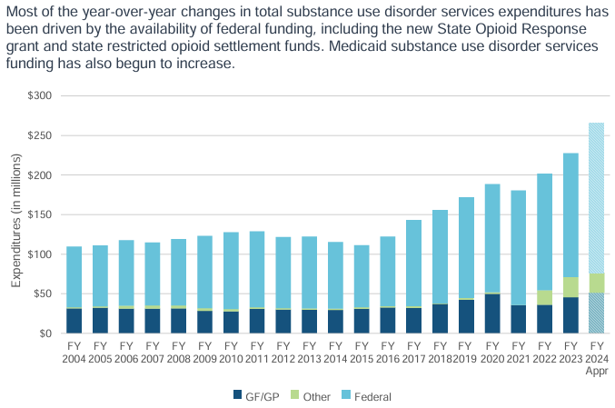
Source: MDHHS, https://www.house.mi.gov/hfa/PDF/Briefings/HHS_Overview_BudgetBriefing_fy23-24.pdf
Notes:
Around 6% or $250M of the $4.5B in mental services spending are spent on substance use disorder services

Slide 17
Addressing Better Outcomes for Individuals
Effects of Medicaid Health Homes among People with Substance Use Disorder and Another Chronic Condition on Health Care Utilization and Spending: Lessons from New York State
41,229 Total Health Home enrollees
Care management programs demonstrated to decrease ED visits and hospitalization among people with SUD
Source: National Library of Medicine, https://pmc.ncbi.nlm.nih.gov/articles/PMC8628019/
Yale Primary Care Internal Medicine Residency Program
All Yale Primary Care residents are required to complete buprenorphine prescribing (X-waiver) training and SBIRT (Screening, Brief Intervention, and Referral to Treatment) training during their first month of residency
Residents regularly rotate through the Addiction Recovery Clinic (ARC). Residents are exposed to patients at various points along the substance use spectrum and learn to apply principles of harm reduction, prescribe medications for addiction treatment, and practice behavioral counseling strategies
Source: Harvard Center for Primary Care, https://info.primarycare.hms.harvard.edu/perspectives/articles/integrating-addiction-treatment-primary-care

Slide 18
Intersection of Physician Activity, Wellness, and Recovery, SAMHSA
Physical activity can help manage cravings, making it easier for people to sustain their recovery. Exercise increases the production of neurotransmitters like dopamine and endorphins, which may be depleted during substance use.
Regular physical activity has been shown to lead to lower rates of returning to problematic substance use for people in recovery from substance use disorder. Physical activity serves as a healthy coping mechanism from stress and may reduce reliance on substances.
The National Institute on Drug Abuse (NIDA) supports including physical activity in treatment programs because of the role exercise plays enhancing brain function and supporting neuroplasticity, which is crucial for recovery.
Source: SAMHSA, https://store.samhsa.gov/sites/default/files/intersection-physical-activity-recovery-pep24-08-006.pdf

Slide 19
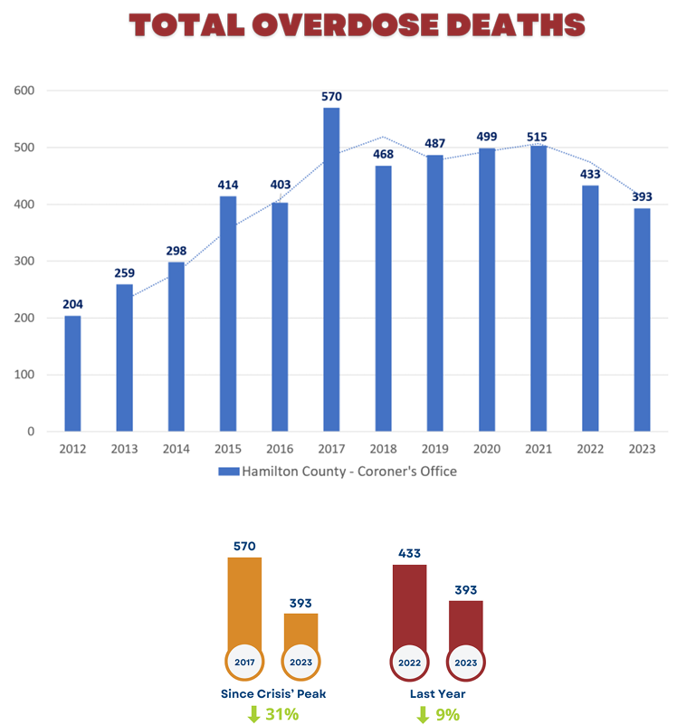
Hamilton County Addiction Coalition, Ohio
150 agencies including law enforcement, public health, SUD treatment clinics/centers, and healthcare providers.
Focus on community navigation towards SUD treatment not incarceration.
Started in 2014 with about a dozen people. Now, there are over 400 people involved
Source: Hamilton County Addiction Coalition, 2023 Annual Report

Slide 20
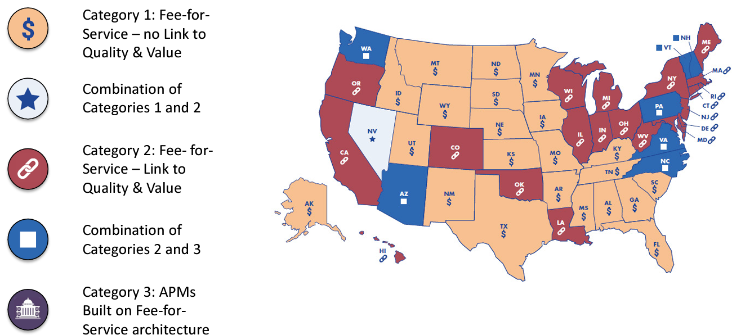
US SUD Payment Model Assessment

Slide 21
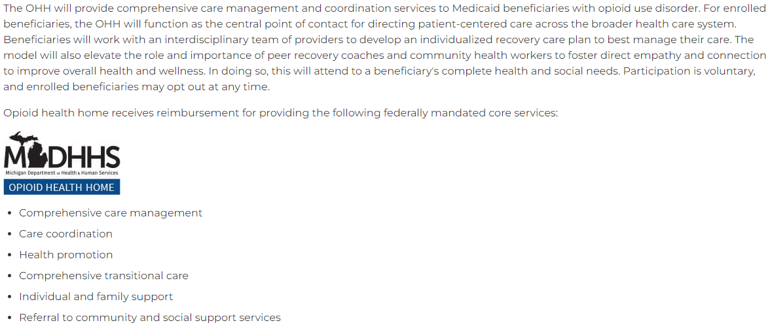
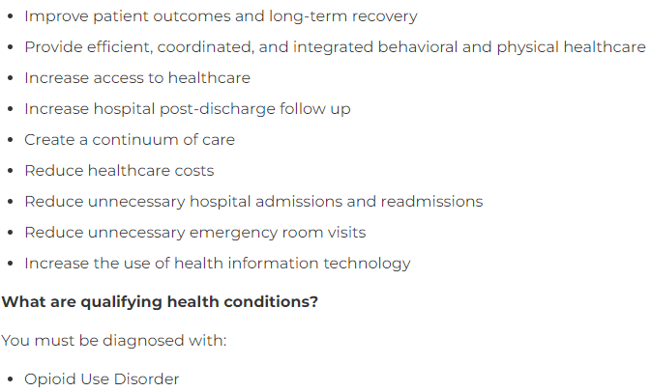
Michigan Opioid Health Home
Source: https://www.michigan.gov/mdhhs/assistance-programs/medicaid/opioid-health-home

Slide 22
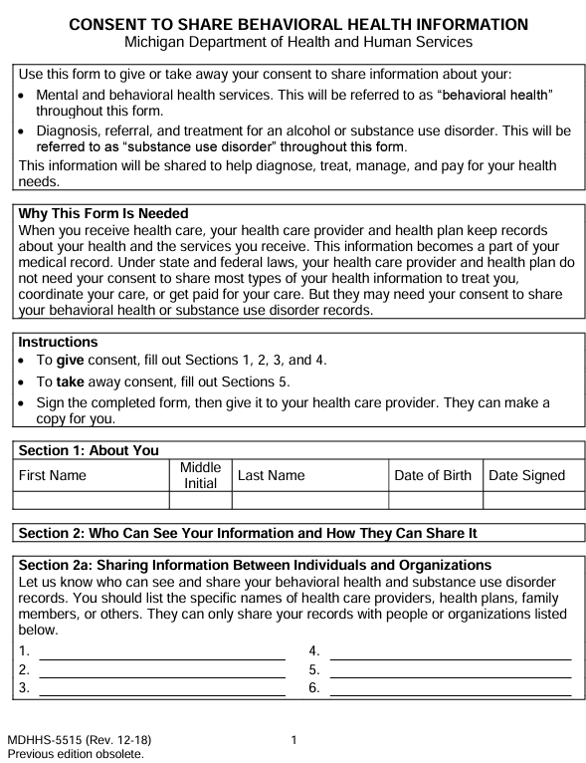
Provider Access Services: Consent to Share SUD/BH Data
Electronic Consent (MDHHS 5515)
During Office or Remote Visit: Patient is informed about sharing SUD and/or Behavioral Health information with MiHIN and selected providers
Explicit Consent + ACRS
Healthcare Services Provider
Payer
Care Coordination

Slide 23
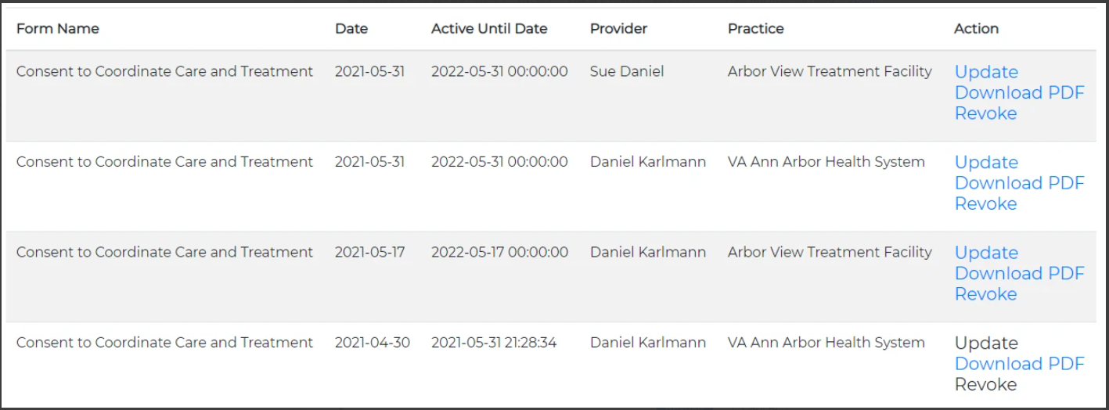
eCMS 3rd Party API Capabilities: Share and Revoke 5515 Consent via API Query and Retrieve 5515 Consent via API (Not Available Today)
MiHIN MIGateway Portal:
15

Slide 24
Individual Access Services (Not Available Today)
Explicit Consent + ACRS
Patient Accesses eCMS through their Patient Portal
Healthcare Services Provider
Payer
Care Coordination

Slide 25
If you, a family member, or a friend needs treatment services for substance abuse, click below links for a local phone number to call for immediate assistance.
Agencies and programs: Click a link below to access a directory of service providers.
Regional Prepaid Inpatient Health Plans (PIHPs)
SAMHSA National Treatment Facility Helpline 1-800-662-HELP (4357)
SAMSHA Approved Buprenorphine Physicians & Programs
SAMHSA Opioid Treatment Program Directory

