Slide 1

February 2024

Slide 2


Michigan Health Information Network Shared Services (MiHIN)
MiHIN is a non-profit organization that provides technology and services to connect disparate sectors to securely, legally, technically and privately share health information.
An unbiased data trustee, MiHIN does not provide health care services or produce health care data.
Instead, we help convene to share vital health information to advance care, better outcomes and lower costs.

Slide 3
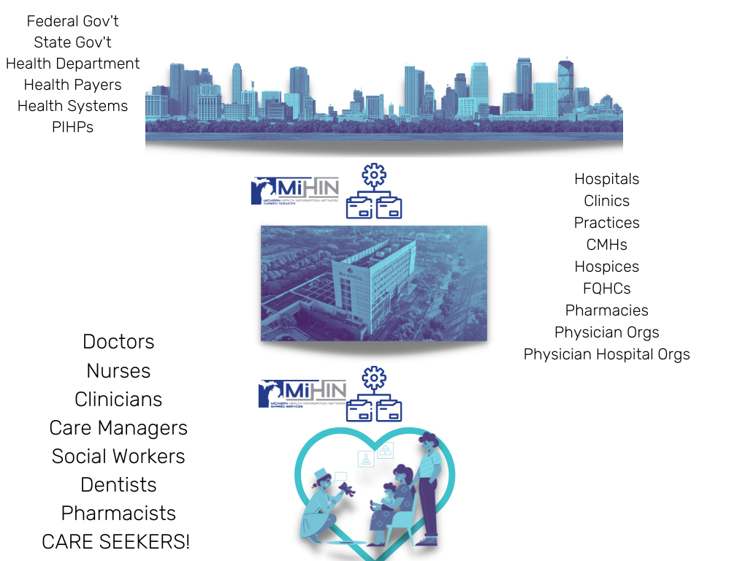
44,582
Michigan care providers with
Active Care Relationships®
through MiHIN, working within
5,637
Michigan care entities
13.1M
Unique Patient Records

Slide 4

Notes:
Volume = equity in health includes social factors, referrals to community based organizations, assessments,
Variety = use case enabler
Velocity = high reliability and availability of services to support 24x7 healthcare

Slide 5
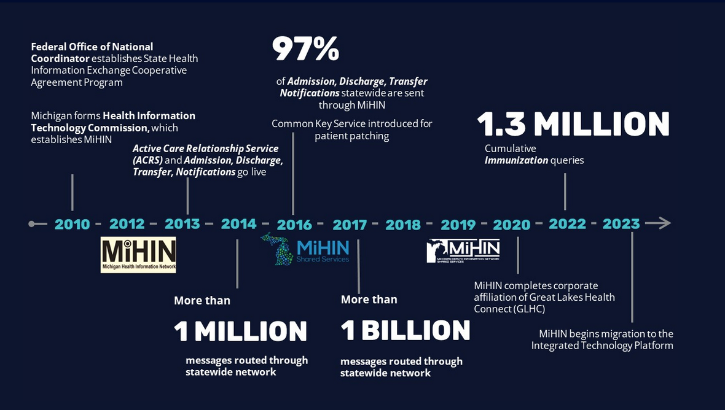

Slide 6
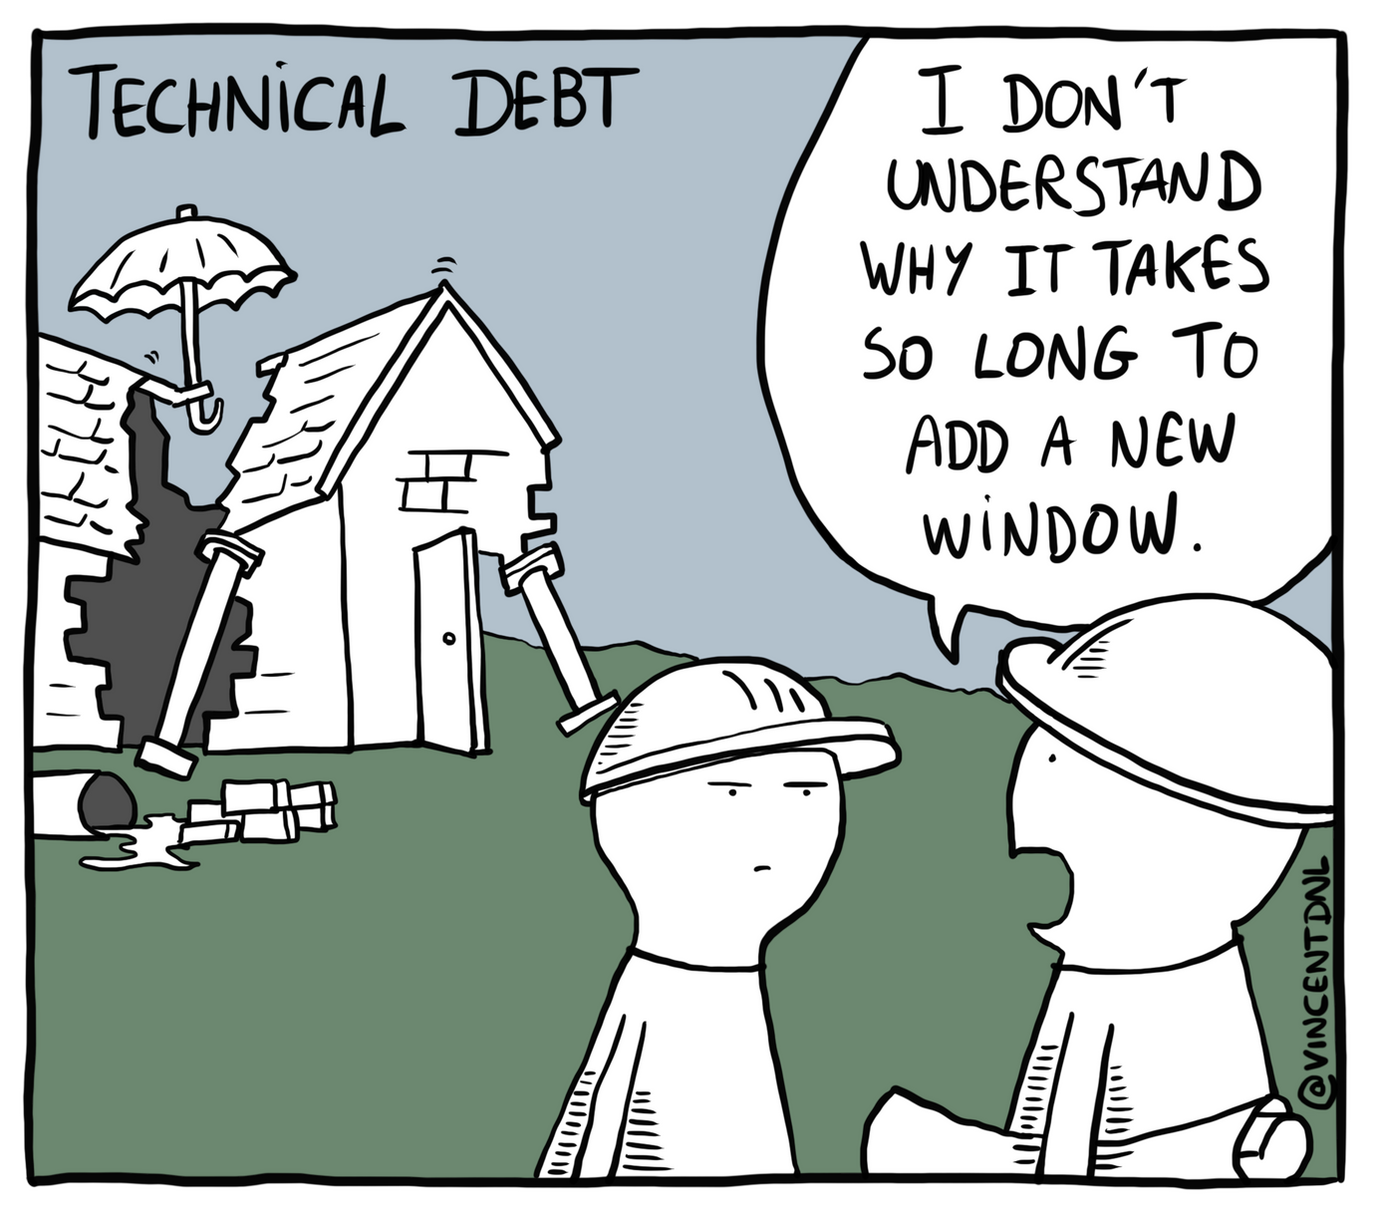
WHY MIGRATION IS NECESSARY
Modernize infrastructure and eliminate duplicative legacy systems
Clean up technical debt for reliability and responsiveness of service
Create the path for required FHIR transformations
Bridge payer and provider environments
Adopt and encourage an “Open Data Model”

Slide 7
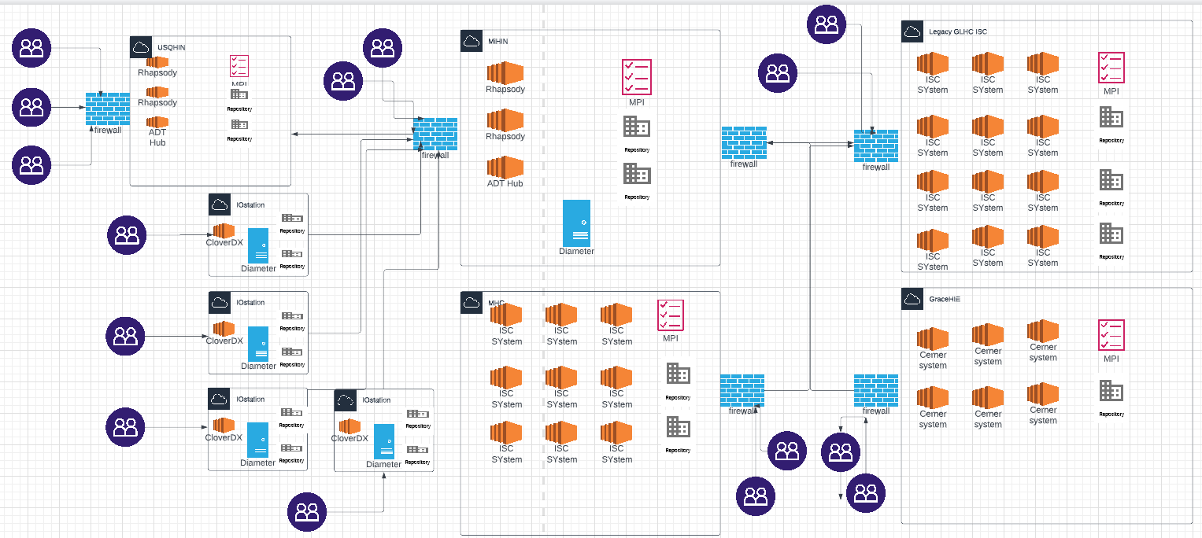
From this:
This is an example of our current technical environment. It is magnificent.
It's taken over a decade to get this much functionality built, and it's a tribute to our state government, our health systems and hospitals, our health insurance providers who have embraced robust information sharing.

Slide 8
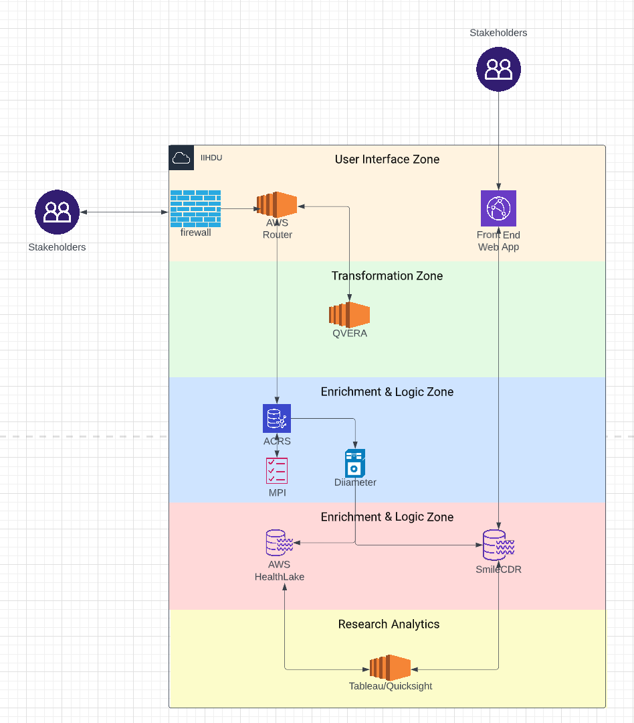
To this:

Slide 9
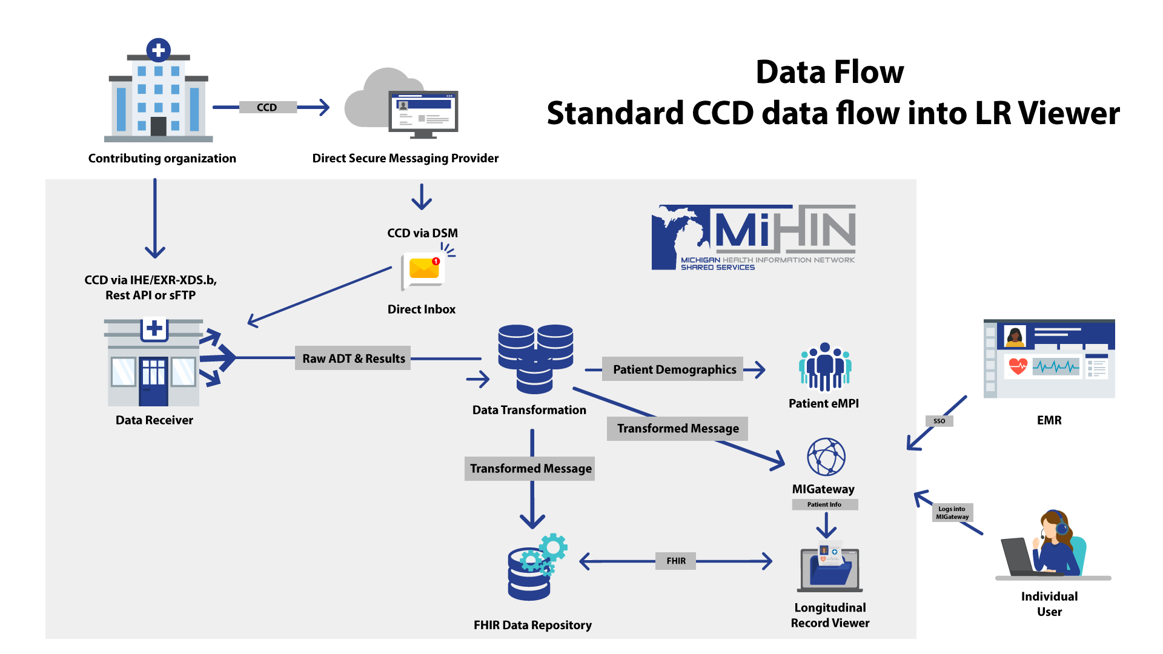

Slide 10
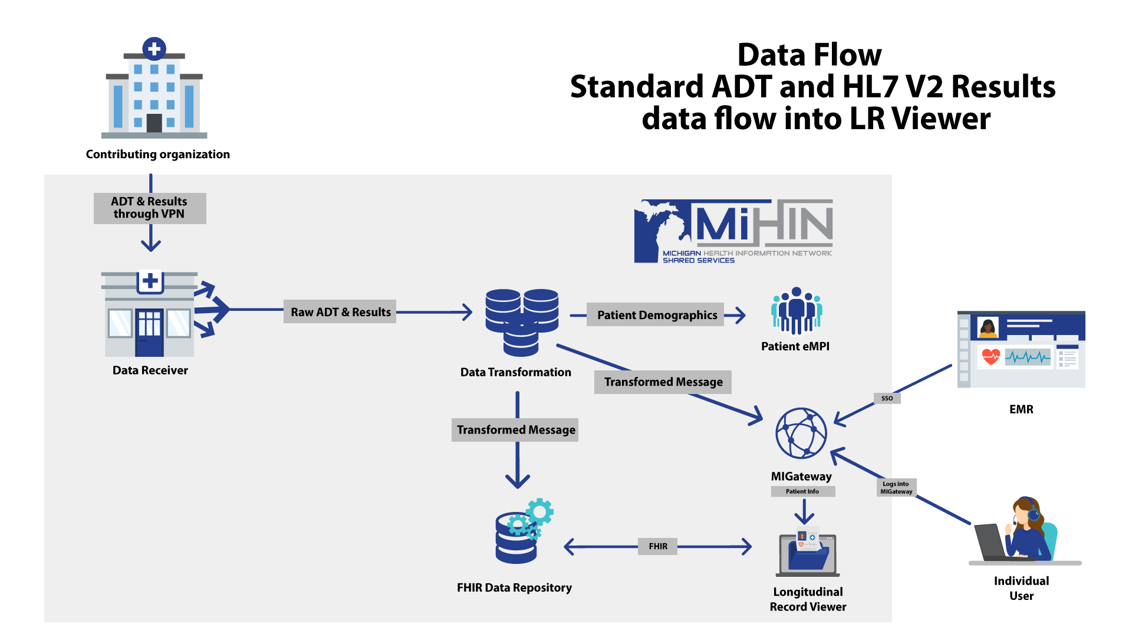

Slide 11
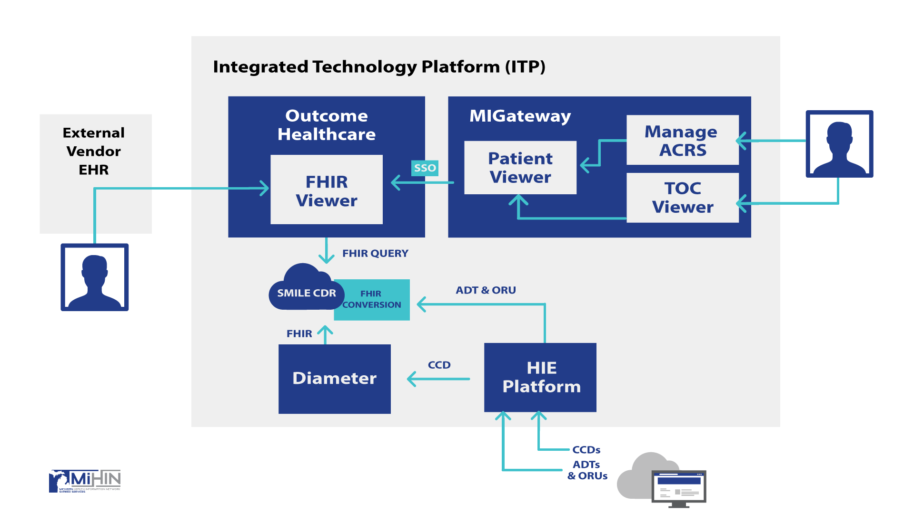

Slide 12

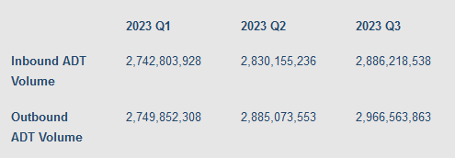
MiHIN is matched by only a handful of other organizations in the world in our volume of ADTs exchange.

Slide 13



Volume – scalable to support billions of clinical messages or thousands of messages per second
Variety - Clinical Data Repository leveraging HAPI FHIR (most popular open-source implementation of HL7 FHIR standard)
Velocity (and Reliability) – Cloud native resources replicated across several data centers to ensure availability of services
Notes:
Volume = equity in health includes social factors, referrals to community based organizations, assessments,
Variety = use case enabler
Velocity = high reliability and availability of services to support 24x7 healthcare

Slide 14

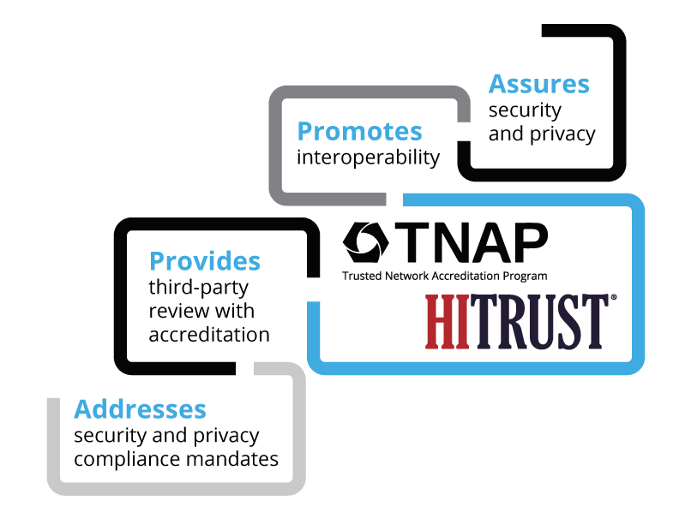



The Robust, Safe & Secure Information Sharing that Michigan Residents Deserve

Slide 15
ITP to benefit Participants
Accelerate completion of new MiHIN technology projects with minimal technical debt:
  Deploy new MiHIN project technologies, longitudinal record solutions, and activate associated Use Cases for projects
  Decommission duplicate legacy technology
Standardize repeatable process and pricing for:
  Customer onboardings
  Deploying use cases to MiHIN customers
  Optimizing the Scoping of new projects
Streamlined operational support and service delivery:
  Help Desk
  Product Support for Fixes, Changes and Enhancements
  Implementations
  On-boarding
Enhance detailed reporting:
  Operational Reporting
  Conformance Reporting
  Requested/Enhanced Client Facing Reports
  Message Volume Reports

Slide 16
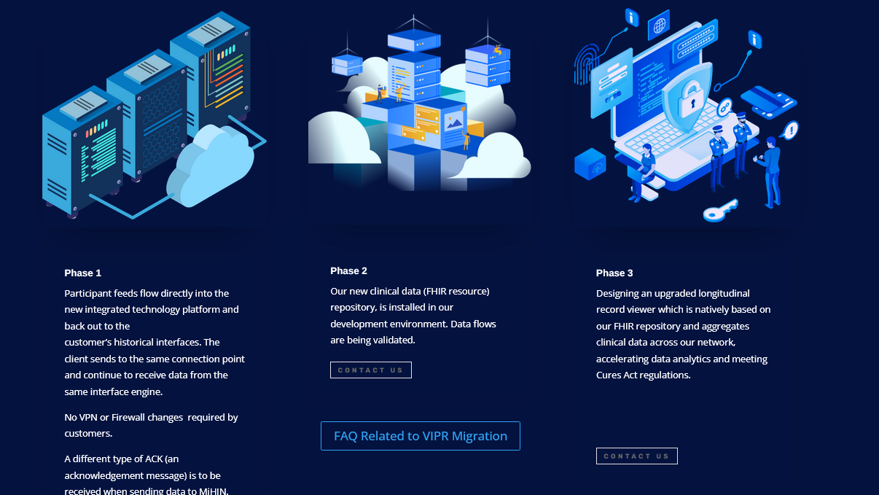
Phase 1
All feeds inventoried and those flowing into legacy system migrated to flow directly into the new integrated technology platform and back out to the customer’s historical interfaces. The client sends to the same connection point and continue to receive data from the same interface engine.
Phase 2
Our new clinical data (FHIR resource) repository, is installed in our development environment. Data flows are validated.
Phase 3
Designing an upgraded longitudinal record viewer which is natively based on our FHIR repository and aggregates clinical data across our network, accelerating data analytics and meeting Cures Act regulations.
Operational Plan –
Example of Accomplishments To Date..

Slide 17
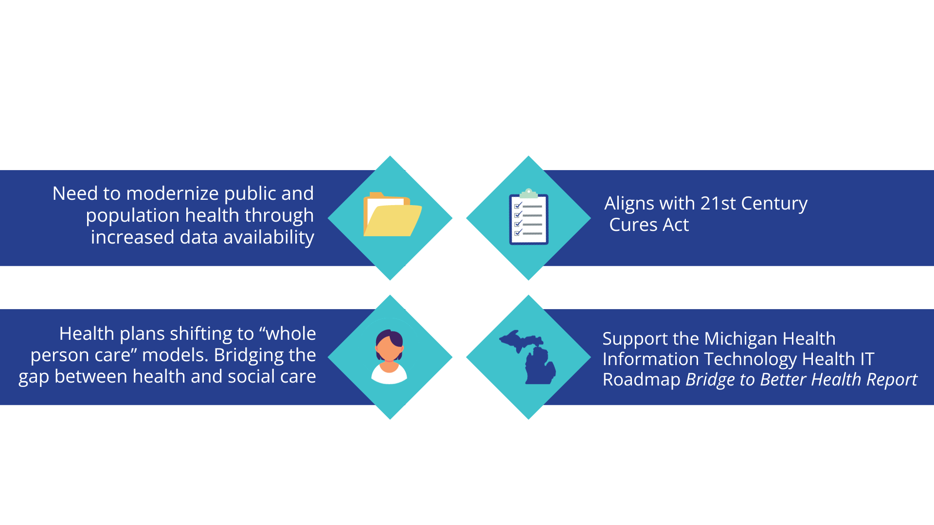
Why is now the right time for this migration?
Notes:
We have been doing this 2010, the time is now to formalize what we do within the state, before the federal government inserts policy that doesn’t align with the great work we accomplished.

Slide 18
2023 Mandates from 21st Century Cures: FHIR Based Exchange
Prior Authorization
  Prior Authorization Requirements, Documentation, and Decision FHIR API
  Fully integrated API which can automate process of pulling Prior Authorization elements from medical record
Payer to Payer Exchange
  Share information with existing and concurrent payers through FHIR API
Provider Access API
  Create FHIR API for providers to access information on their patients
  Leverage Health Information Networks for provider patient attribution

Slide 19
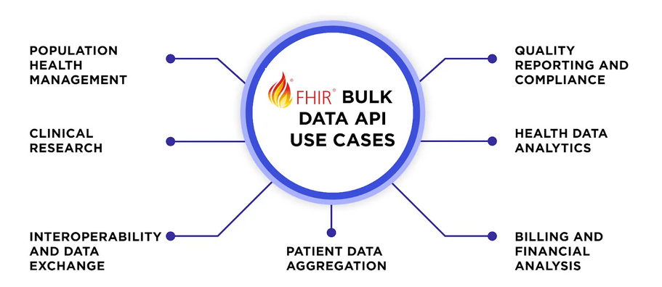
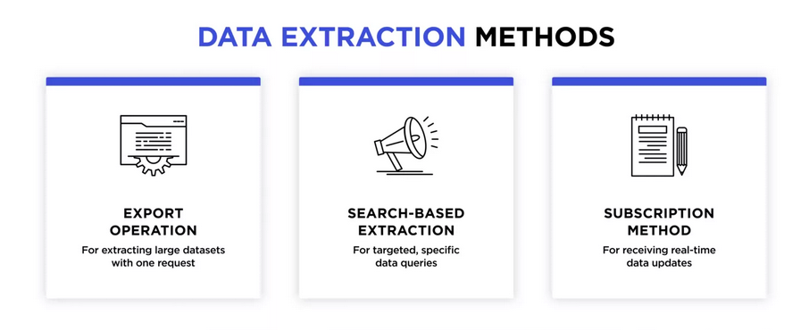
ITP will facilitate population-level data extraction to empower healthcare providers and public health authorities to access and export vast amounts of patient information for better data analysis at scale, smoother operating healthcare systems, and interoperability.

Slide 20

Change is the only constant.
Our Mission:
Michigan Health Information Network Shared Services (MiHIN) is a public and private non-profit collaboration dedicated to transforming the healthcare experience, improving quality, and decreasing by supporting the statewide exchange of health information.

Slide 21


